Slide 1



The Prescription Opioid and Heroin Crisis:
An Epidemic of Addiction
Andrew Kolodny, M.D.
Chief Medical Officer, Phoenix House Foundation Inc.
Executive Director, Physicians for Responsible Opioid Prescribing
Senior Scientist, Heller School for Social Policy and Management, Brandeis University
Research Professor, Global Institute of Public Health, New York University

Slide 2

Opium

Slide 3
Unintentional Drug Overdose Deaths
United States, 1970–2007
43,982 drug overdose deaths in 2013
Cocaine
Heroin
Year
National Vital Statistics System, http://wonder.cdc.gov
Notes:
Focusing in on just the unintentional overdoses and looking at long-term trends reveals that the recent numbers are unprecedented. They are part of the worst overdose epidemic in the United States in over 4 decades. The epidemics of black tar heroin in the 1970s and crack cocaine in the late 1980s and early 1990s barely register when compared to the magnitude of this epidemic.
Over 27,000 unintentional drug overdose deaths occurred in 2007 in the United States - one every 19 minutes. In 17 states, it is now the leading cause of injury death.

Slide 4
Drug Overdose Deaths by Major Drug Type,
United States, 1999–2010
CDC, National Center for Health Statistics, National Vital Statistics System, CDC Wonder. Updated with 2010 mortality data.

Slide 5
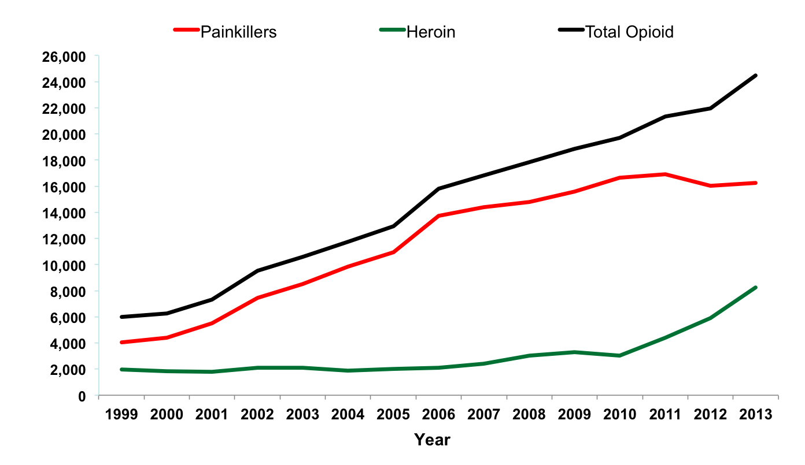
Opioid Related Overdose Deaths United States, 1999-2013

Slide 6
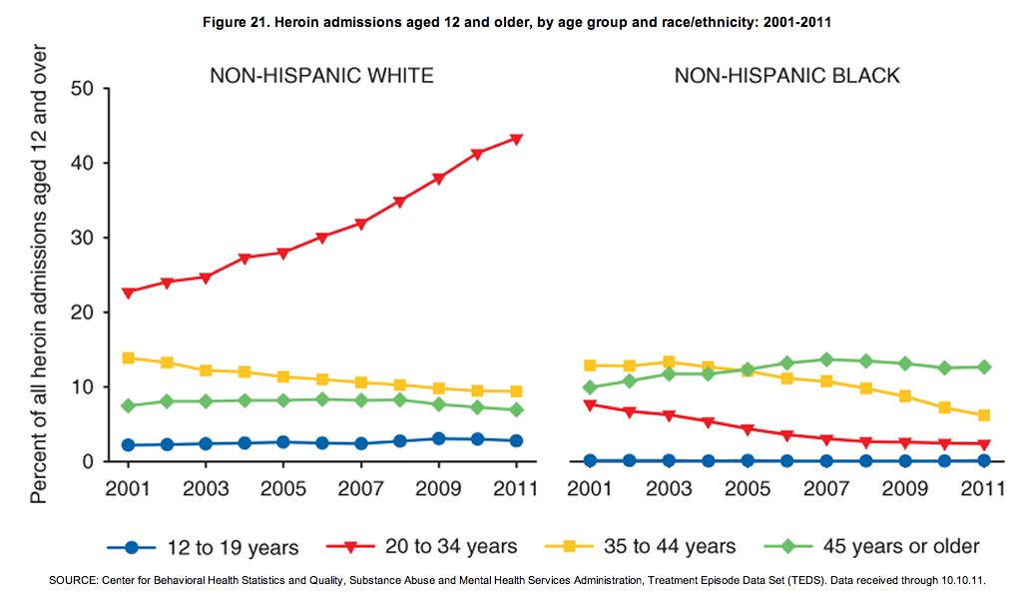
Heroin admissions, by age group & race/ethnicity: 2001- 2011

Slide 7
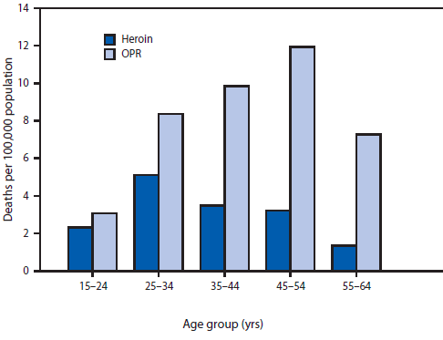
Death rates from overdoses of heroin or prescription opioid pain relievers (OPRs), by age group
SOURCE: CDC. Increases in Heroin Overdose Deaths — 28 States, 2010 to 2012
MMWR. 2014, 63:849-854

Slide 8
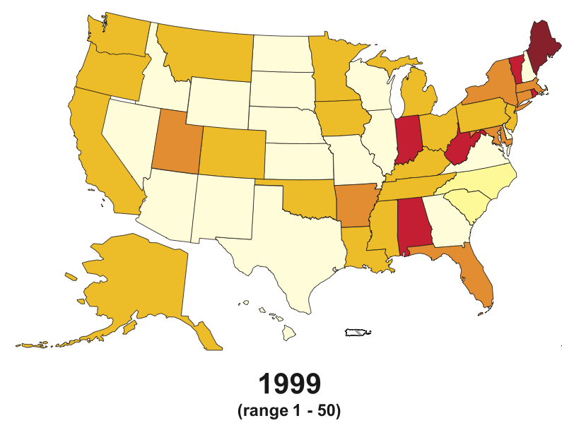
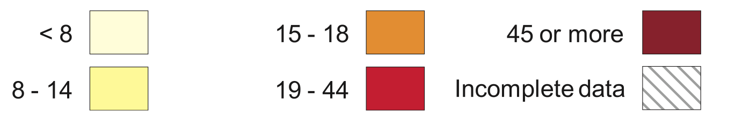
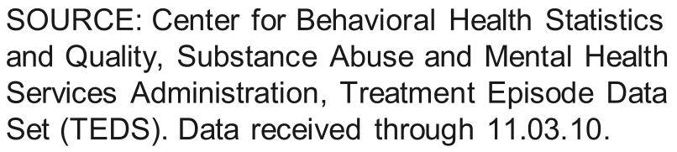
Primary non-heroin opiates/synthetics admission rates, by State
(per 100,000 population aged 12 and over)

Slide 9
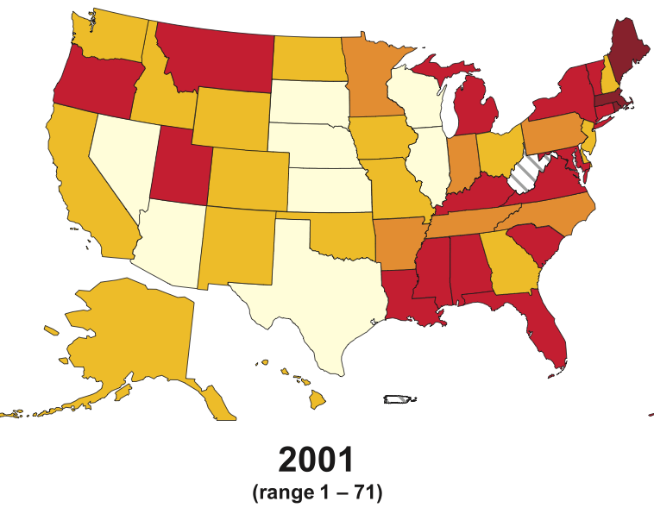
Primary non-heroin opiates/synthetics admission rates, by State
(per 100,000 population aged 12 and over)

Slide 10
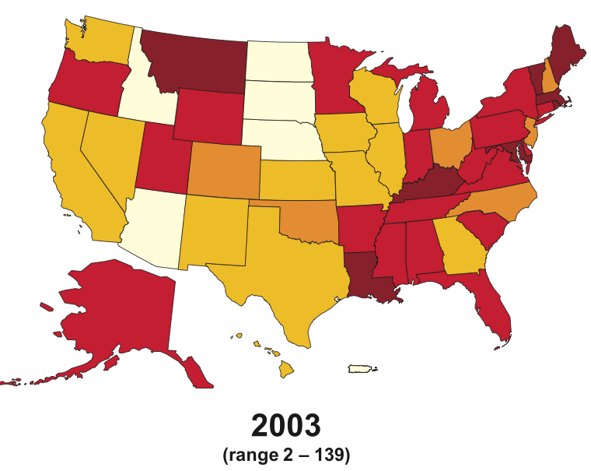
Primary non-heroin opiates/synthetics admission rates, by State
(per 100,000 population aged 12 and over)

Slide 11
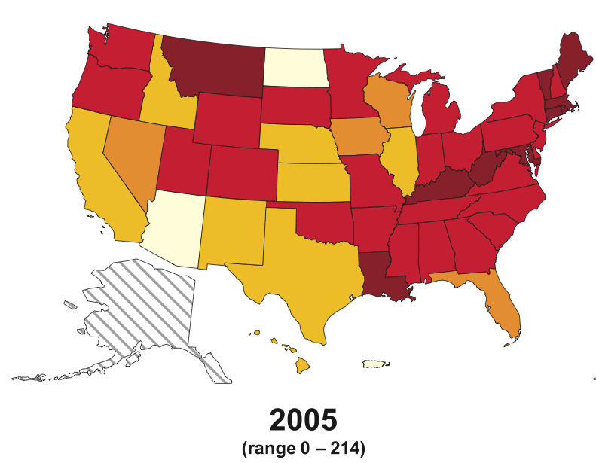
Primary non-heroin opiates/synthetics admission rates, by State
(per 100,000 population aged 12 and over)

Slide 12
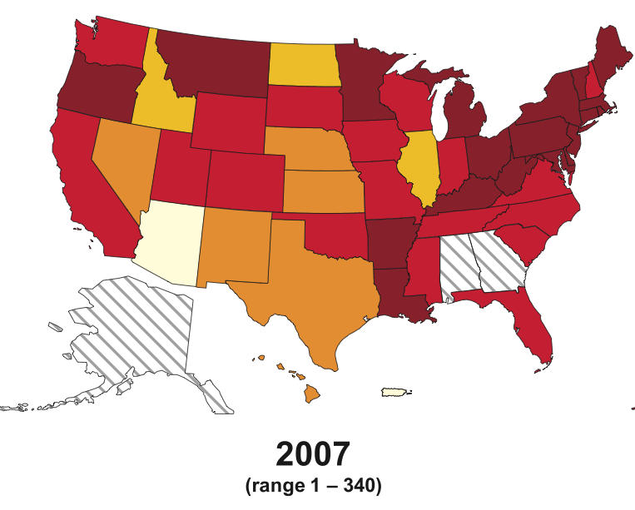
Primary non-heroin opiates/synthetics admission rates, by State
(per 100,000 population aged 12 and over)

Slide 13
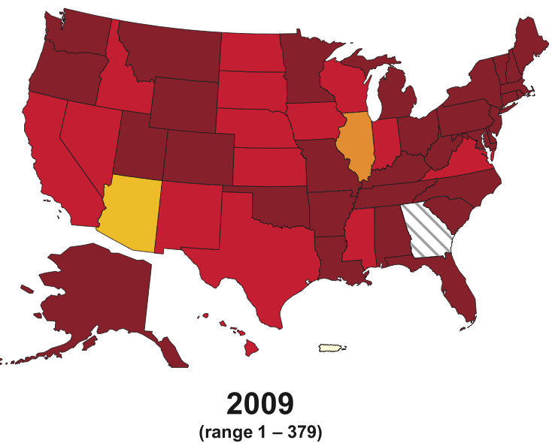
Primary non-heroin opiates/synthetics admission rates, by State
(per 100,000 population aged 12 and over)

Slide 14
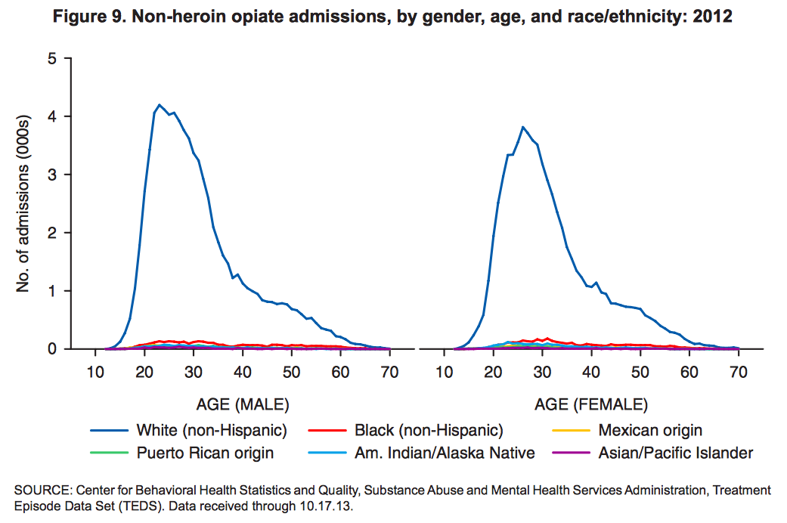

Slide 15
Unintentional overdose deaths involving opioid analgesics parallel per capita sales of opioid analgesics in morphine equivalents by year, U.S., 1997-2007
*
Number of
Deaths
Opioid sales (mg/person)
Source: National Vital Statistics System, multiple cause of death dataset, and DEA ARCOS
* 2007 opioid sales figure is preliminary.
Notes:
In the 1990s, physicians liberalized their use of powerful prescription painkillers called opioid analgesics. During the same decade, long-acting forms of these analgesics such as the fentanyl patch and OxyContin came on the market and quickly became popular. Sales data tracked by the Drug Enforcement Administration indicates that opioid sales per person in morphine milligram equivalents rose dramatically as a result. Drug companies distributed 96 milligrams per person in the US in 1997 and 613 milligrams per person by 2006, an increase of over 500%. One of the opioid analgesics, hydrocodone, quickly rose to become the most prescribed drug in the US, with over 117 million prescriptions in 2007.
By 1999, however, it was already apparent that opioid analgesics were increasingly involved in fatal drug overdoses. Examination of drugs recorded on overdose death certificates reveals that this trend has only worsened in subsequent years. In 1999, opioid analgesics were recorded as a cause of death in 2,901 overdose fatalities. By 2006, this number had increased to 10,986, an increase of almost 300%. Therefore, increases in opioid overdoses have been an unintended consequence of the increase in use of opioids by physicians.

Slide 16
Rates of Opioid Sales, OD Deaths, and Treatment, 1999–2010
CDC. MMWR 2011

Slide 17
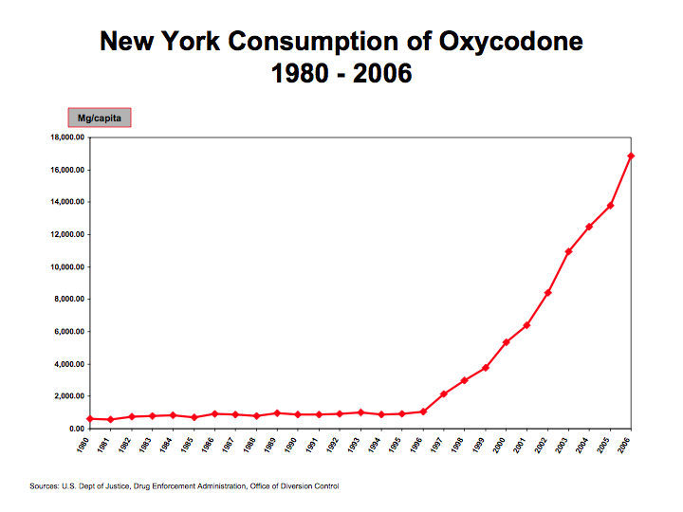

Slide 18
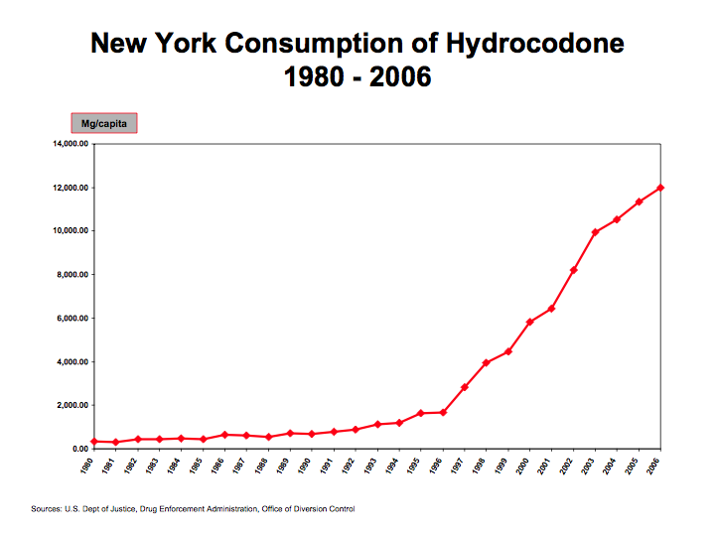

Slide 19
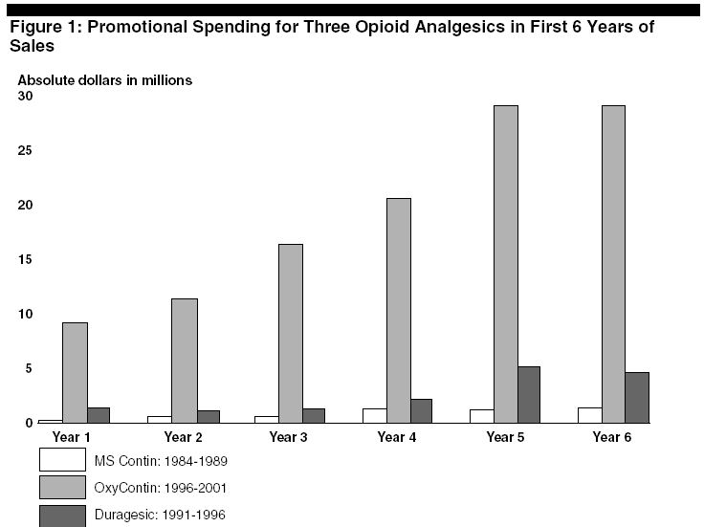
Dollars Spent Marketing OxyContin (1996-2001)
Source: United States General Accounting Office: Dec. 2003, “OxyContin Abuse and Diversion and Efforts to Address the Problem.”

Slide 20
Industry-funded “educational” messages
Physicians are needlessly allowing patients to suffer because of “opiophobia.”
Opioid addiction is rare in pain patients.
Opioids can be easily discontinued.
Opioids are safe and effective for chronic pain.

Slide 21
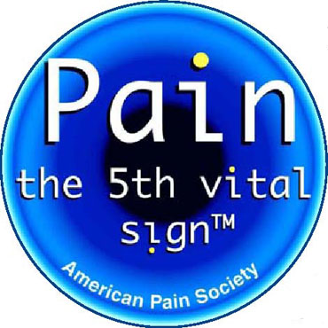
Industry-funded organizations campaigned for greater use of opioids
Pain Patient Groups
Professional Societies
The Joint Commission
The Federation of State Medical Boards

Slide 22
“The risk of addiction is much less than 1%”
Porter J, Jick H. Addiction rare in patients treated with narcotics. N Engl J Med. 1980 Jan 10;302(2):123
Cited 824 times (Google Scholar)

Slide 23
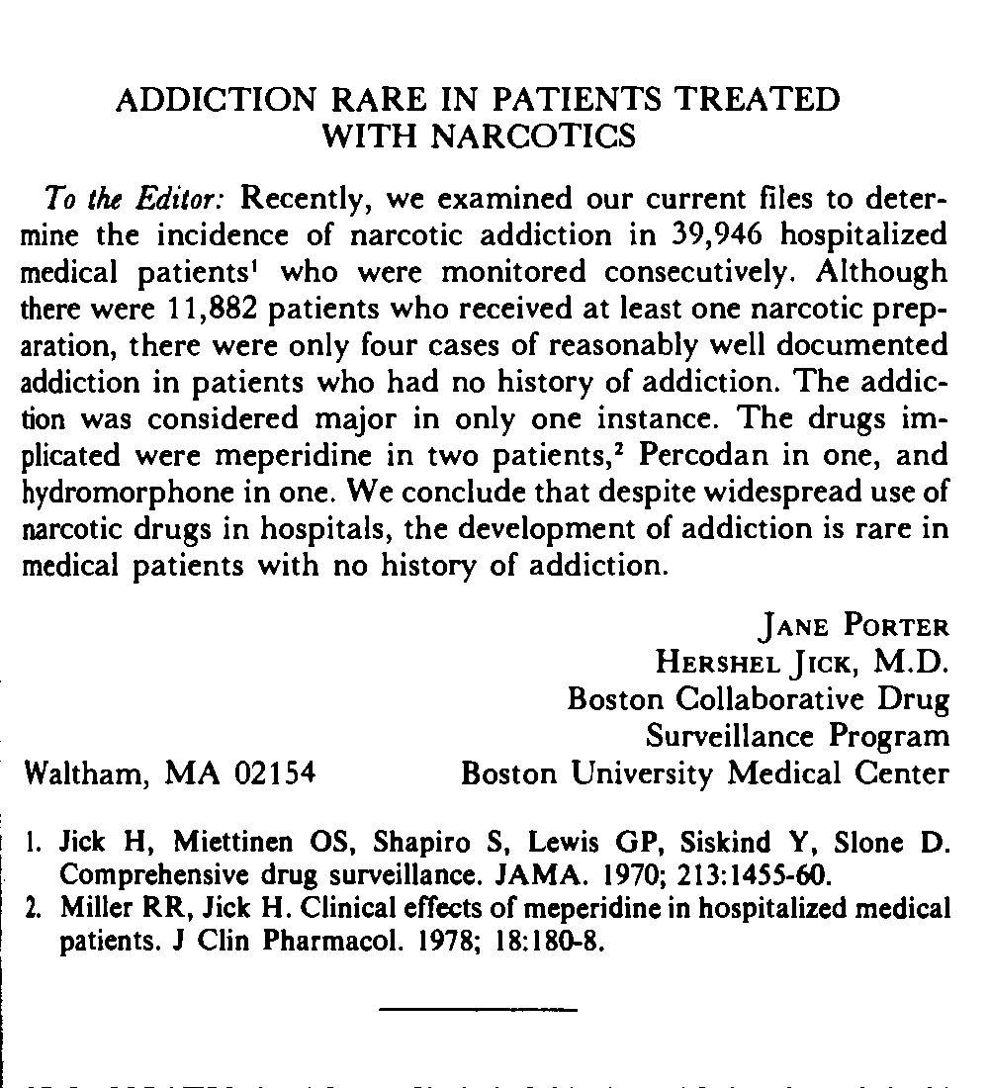
N Engl J Med. 1980 Jan 10;302(2):123.

Slide 24
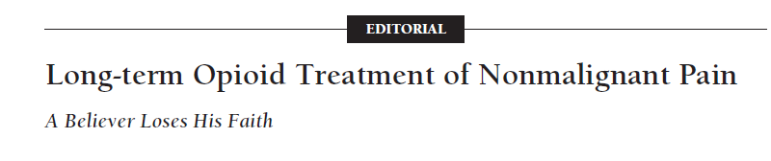
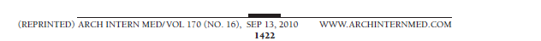
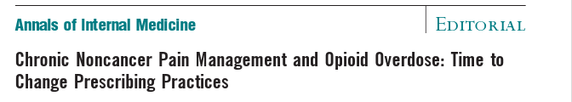
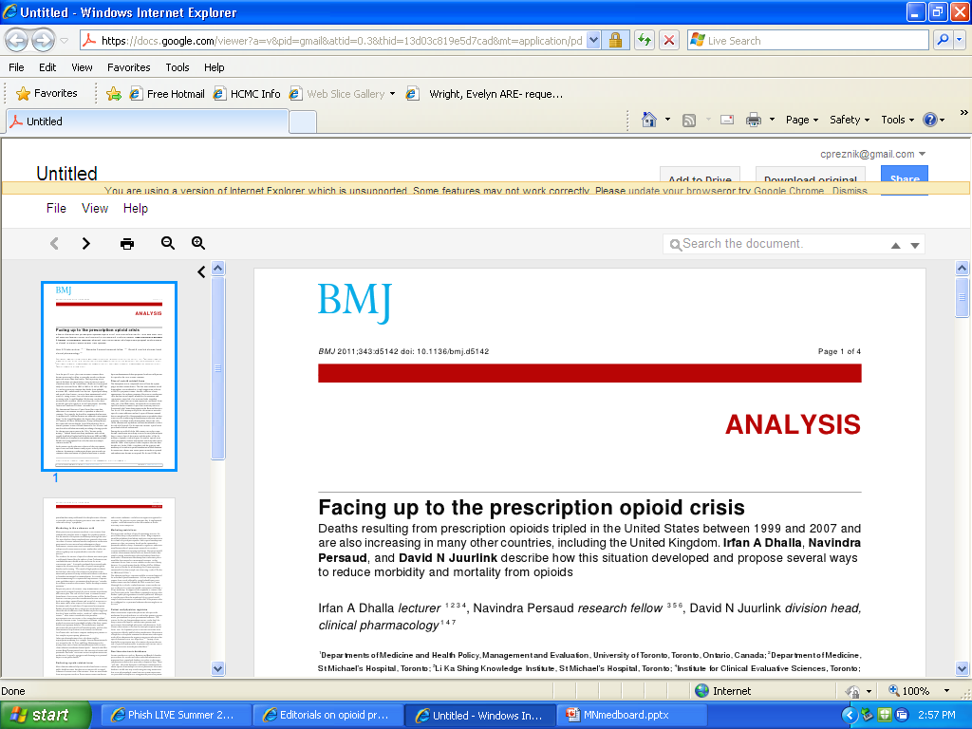
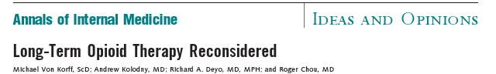
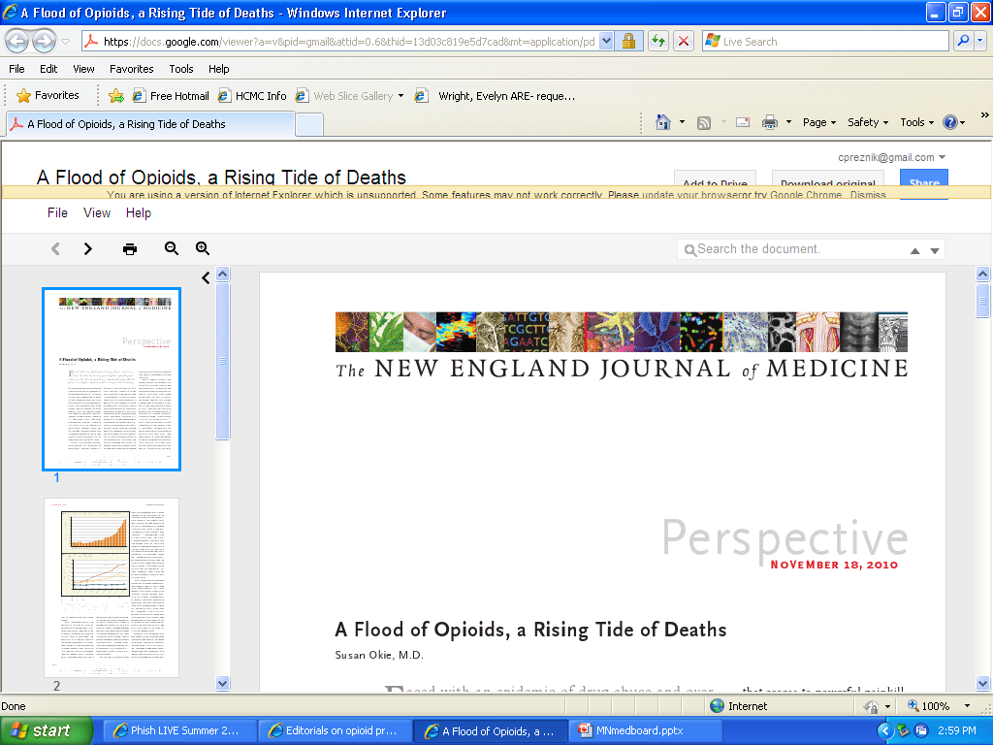
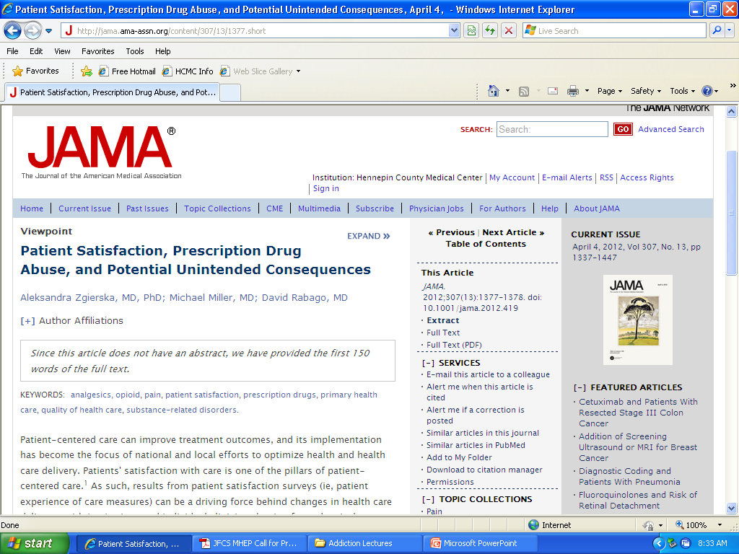

Slide 25
Controlling the epidemic:
A Three-pronged Approach
Prevent new cases of opioid addiction.
Treatment for people who are already addicted.
Reduce supply from pill mills and the black-market.

Slide 26

Teenage brains may be more vulnerable to addiction

Slide 27
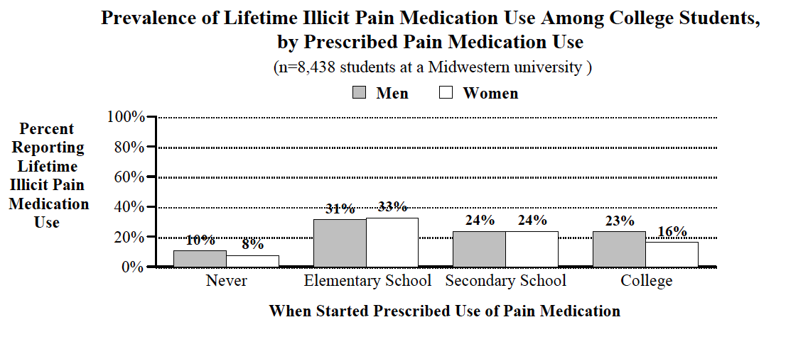
Nonmedical Use in College is Most Common in Students Prescribed Opioids as Children
McCabe, S.E.; Teter, C.J.; and Boyd, C.J. “Illicit Use of Prescription Pain Medication Among College Students,” Drug and Alcohol Dependence77(1):37-47, 2005

Slide 28


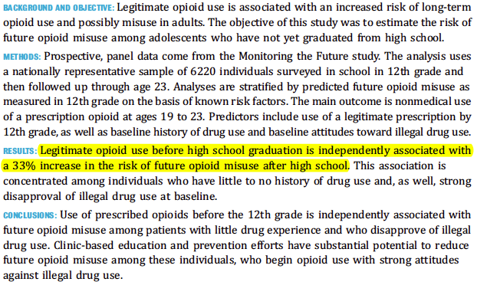

Slide 29
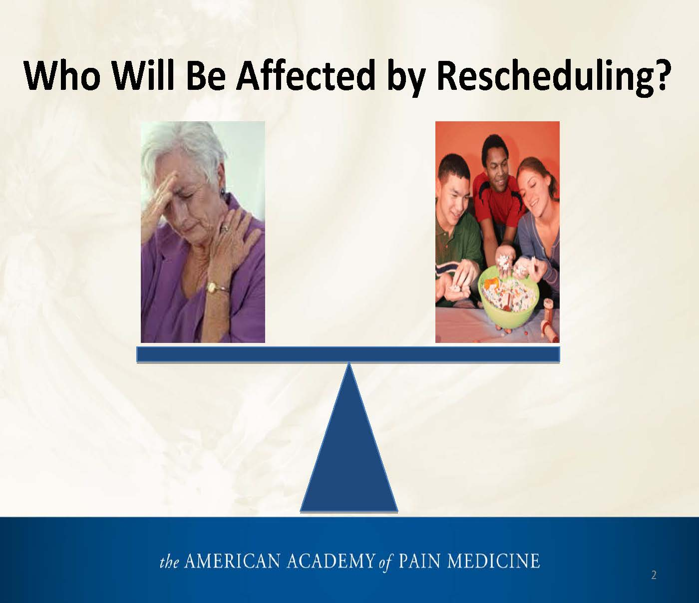
How the opioid lobby frames the problem:
Source: Slide presented by Lynn R. Webster MD at FDA meeting on hydrocodone upscheduling, January 25th, 2013.

Slide 30

This is a false dichotomy
Opioid harms are not limited to so-called “drug abusers”
35% met DSM V criteria for an opioid use disorder¹
Pain Patients
“Drug Abusers”
92% of opioid OD decedents were prescribed opioids for chronic pain.²
1. Boscarino JA, Rukstalis MR, Hoffman SN, et al. Prevalence of prescription opioid-use disorder among chronic pain patients: comparison of the DSM-5 vs. DSM-4 diagnostic criteria. J Addict Dis. 2011;30:185-194.
2. Johnson EM, Lanier WA, Merrill RM, et al. Unintentional Prescription Opioid-Related Overdose Deaths: Description of Decedents by Next of Kin or Best Contact, Utah, 2008-2009. J Gen Intern Med. 2012 Oct 16.

Slide 31
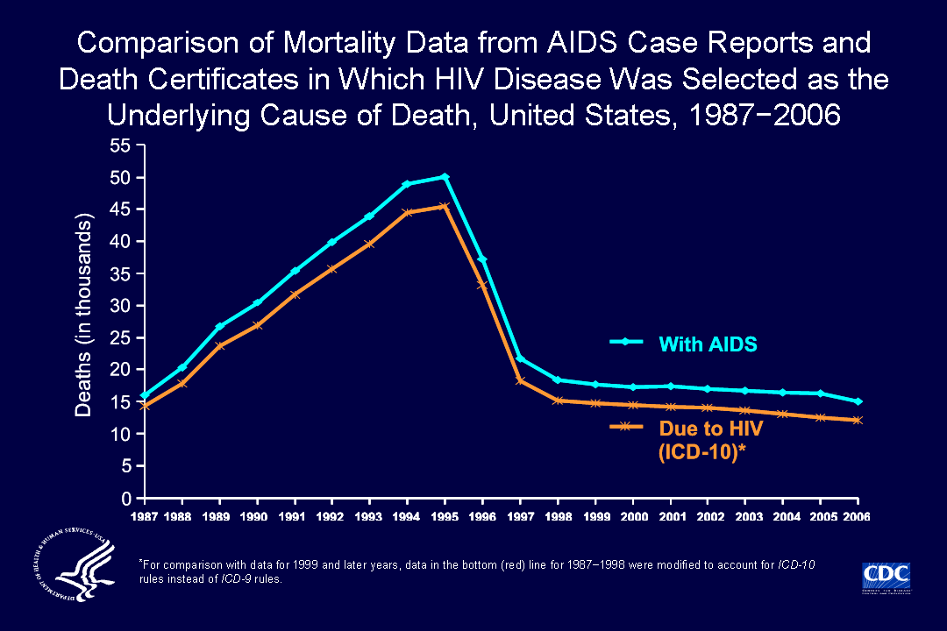
Notes:
The annual number of deaths of persons with AIDS (some of which were not caused by AIDS), as reported to the national HIV surveillance system through June 30, 2008, and adjusted for reporting delay, was 9% to 23% (depending on the year) greater than the number of deaths attributed to HIV disease in death certificate data (by ICD-10 rules for selecting the underlying cause of death). The greater number of deaths of persons with AIDS is partly because some persons with AIDS die of causes not attributable to HIV disease, such as motor vehicle accidents, and partly because some deaths due to HIV disease are not reported as such on death certificates.

Slide 32

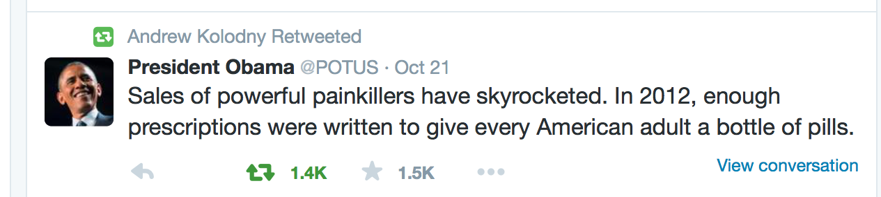
President Obama discussing the opioid addiction epidemic in West Virginia

Slide 33
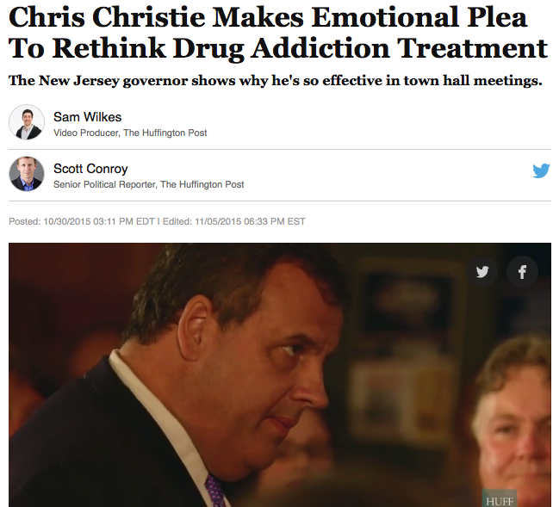

Slide 34
Summary
The U.S. is in the midst of a severe epidemic of opioid addiction
To bring the epidemic to an end:
  We must prevent new cases of opioid addiction
  We must ensure access to treatment for people already addicted

