Slide 1
Prescription Opioid Abuse
William Holubek, MD, MPH, FACEP, FACMT
Chief Medical Officer
CarePoint Health – Christ Hospital

Slide 2
No conflicts of interest.

Slide 3
Topics
Epidemiology - stats
Toxicity of opioids
PDMP
CarePoint Health policy
The ALTOSM Program

Slide 4
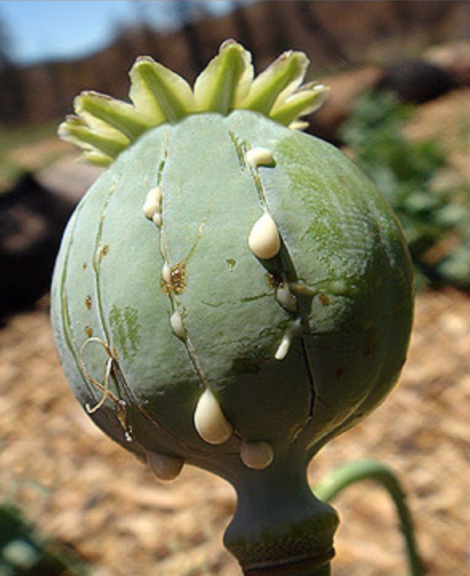
A Few Definitions
Opiate
Naturally derived directly from the opium poppy
Morphine, codeine (thebaine, noscapine)
Opioid
Opium-like effects
Binding to opioid receptor
oxycodone, hydrocodone, heroin, Fentanyl
Narcotic
A drug that dulls the senses, relieves pain, and induces sleep
Benzodiazepines, opioids, ethanol
Currently used for any psychoactive substance
Notes:
Why is this important?
You combine a narcotic and opioid = potentially exponential effect = possible death

Slide 5
Fact #1 - CDC
Overdose deaths involving prescription opioids have quadrupled since 1999, and so have the sales of prescription drugs.
Opioid Overdose. Website: http://www.cdc.gov/drugoverdose/data/overdose.html. Accessed June 6, 2016.

Slide 6
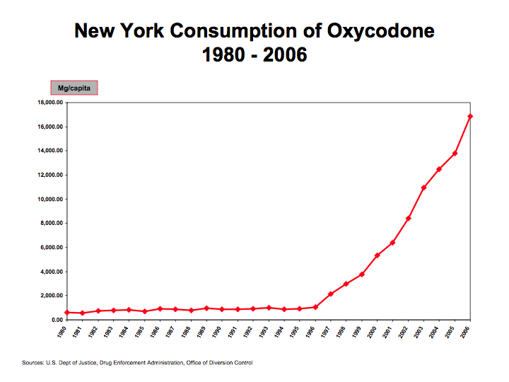
Courtesy of Dr Andrew Kolodny.

Slide 7
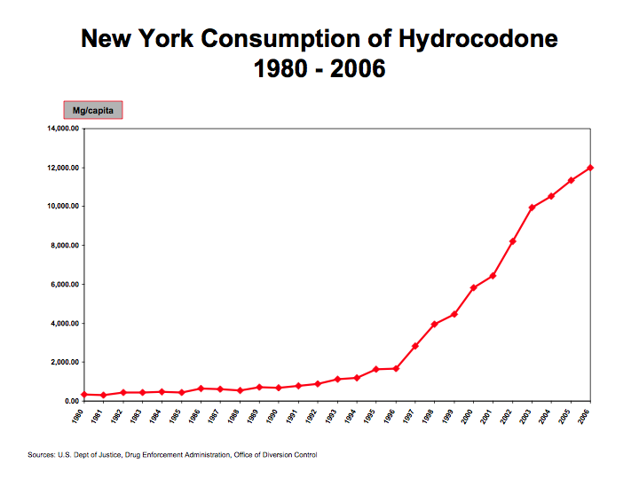
Courtesy of Dr Andrew Kolodny.

Slide 8
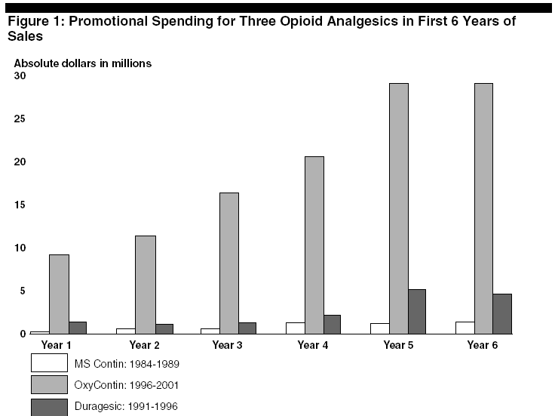
Dollars Spent Marketing OxyContin (1996-2001)
Source: United States General Accounting Office: Dec. 2003, “OxyContin Abuse and Diversion and Efforts to Address the Problem.”
Courtesy of Dr Andrew Kolodny.

Slide 9
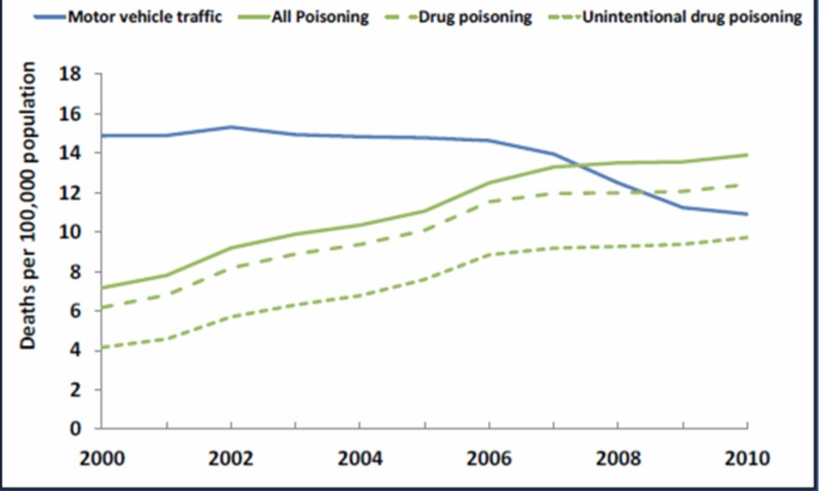
Death Rates in the U.S. 1999-2010
National Capital Poison Center. Website: www.poison.org. Accessed June 6, 2016.
Notes:
Unintentional – meaning general, misuse (co-ingestion), therapeutic (double-dose)
- Rates were higher in ages 25-55yo
Rates were higher in white and American Indian
Rates higher in men than women but gap is closing

Slide 10
Fact #2 - CDC
In 2012, health care providers wrote 259 million prescriptions for opioid pain medication, enough for every adult in the U.S. to have a bottle of pills.
Opioid Overdose. Website: http://www.cdc.gov/drugoverdose/data/overdose.html. Accessed June 6, 2016.

Slide 11
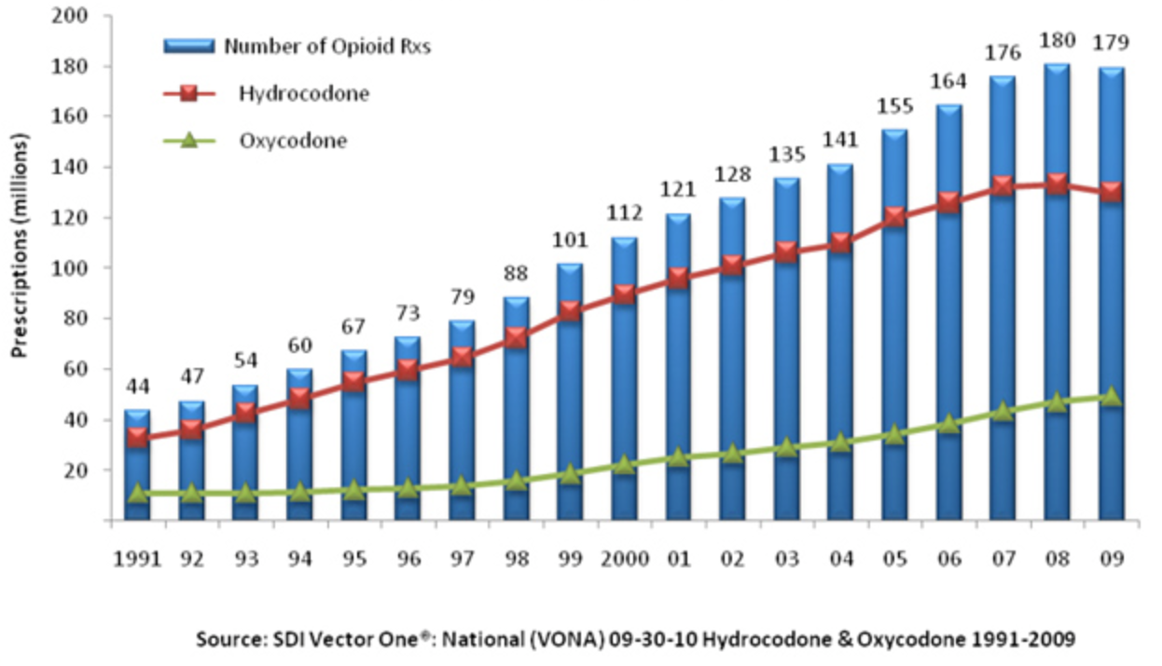
Number of Hydrocodone & Oxycodone Prescriptions, Dispensed by U.S. Retail Pharmacies, 1991-2009
Prescription Drug Addiction Graphs. Website: http://www.inspiremalibu.com. Accessed June 6, 2016.
Notes:
Methadone is the other prescription opioid most commonly involved in overdose deaths.

Slide 12
Fact #3 - AAPCC
In 2010, the number of deaths from prescription opioid or narcotic pain relievers exceeded the number of overdose deaths from heroin and cocaine combined.
AAPCC Poison Statistics, National Data 2013.
Notes:
including drugs such as Vicodin (hydrocodone), OxyContin (oxycodone), Opana (oxymorphone), and methadone –

Slide 13
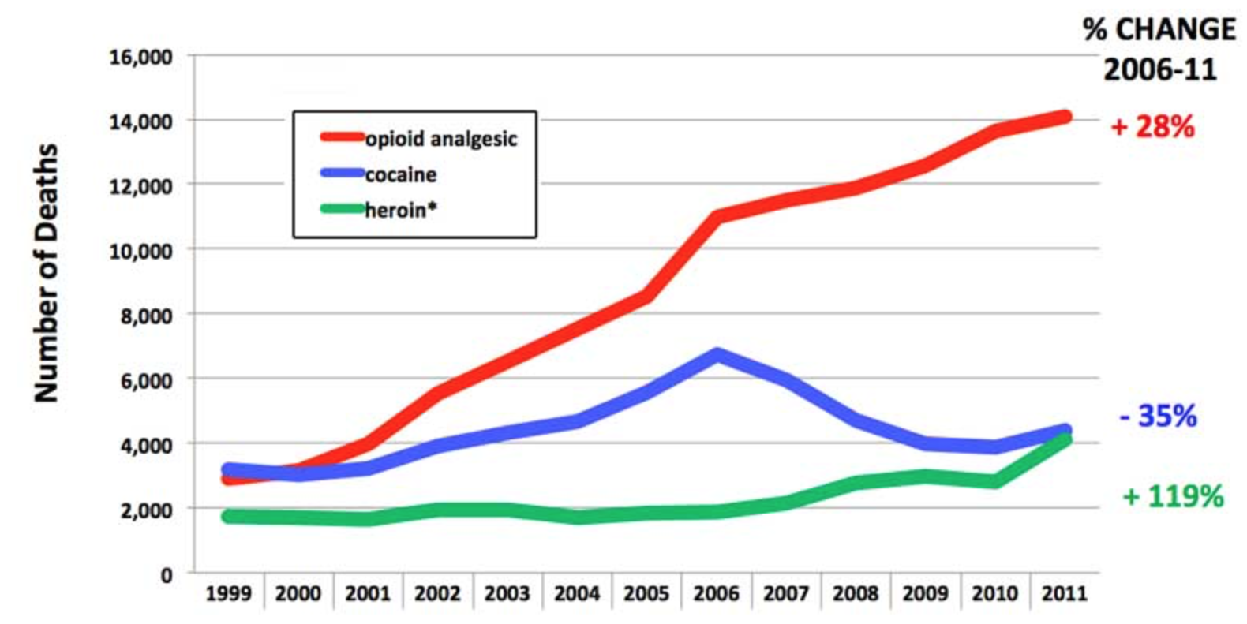
Unintentional Drug Poisoning Deaths: U.S. 1999-2011
National Institute on Drug Abuse. June 24, 2014.
Notes:
* Includes opium; also includes illicit fentanyl

Slide 14
Fact #4 - CDC
Today, at least half of all U.S. opioid overdose deaths involve a prescription opioid.
Opioid Overdose. Website: http://www.cdc.gov/drugoverdose/data/overdose.html. Accessed June 6, 2016.
Notes:
including drugs such as Vicodin (hydrocodone), OxyContin (oxycodone), Opana (oxymorphone), and methadone –

Slide 15
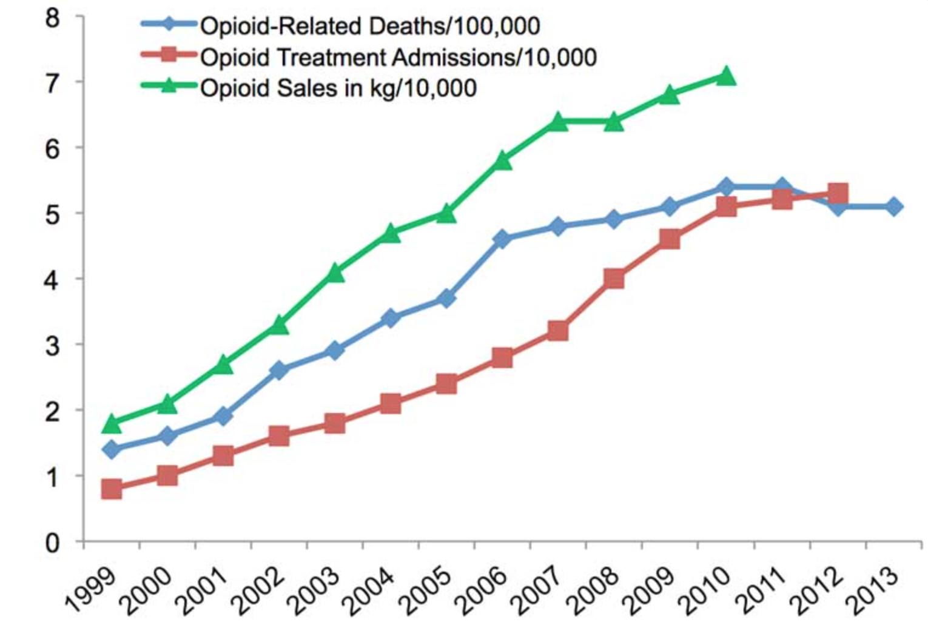
Opioid Sales, Opioid treatment admissions, and Opioid-related deaths
National Institute on Drug Abuse. Website: https://www.drugabuse.gov. Accessed June 6, 2016.
Notes:
Looks like deaths are leveling off, but 2014 data just available shows a 9% increase.

Slide 16
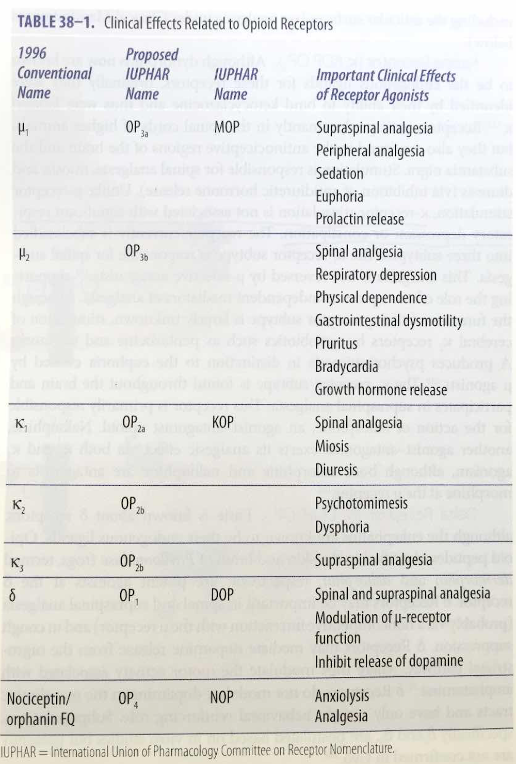
Opioid Toxicity
Death is from apnea.
Other effects:
seizures
cardiac
Serotonin syndrome
Opioids. Goldfranks Toxicological
Emergencies, 10th Ed. 2015.
Notes:
OP = opioid peptide
Opioid syndrome: mental status depression, hypoventilation, miosis, hypoperistalsis

Slide 17
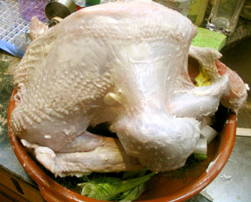
Opioid Withdrawal
Signs and symptoms include piloerection, diaphoresis, mydriasis, yawning, hypertension, and tachycardia; nausea, vomiting, diarrhea, and back pain.
Notes:
Opiods and clonidine both bind to central alpha-2 receptors, increasing K+ efflux, thus decreasing NE release; this may explain why clonidine may help with mild symptoms of opioid w/d.
natural opioid w/d is not life=threatening; you feel crappy but you won’t die; cold turkey!

Slide 18
Naloxone (Narcan)
Competitive antagonist at all opioid receptors
Can be administered via many routes.
IV, IM, SC, IN, nebulized, submucosal, rectal
Onset of action for IV: 1-2 minutes
unpredictable onset for other routes
Duration of action: 20-90 minutes
Dose: 0.04mg IV
will reverse respiratory depression in majority of cases
Infusion: 2/3 effective dose per hour
Be mindful of co-ingestants!

Slide 19
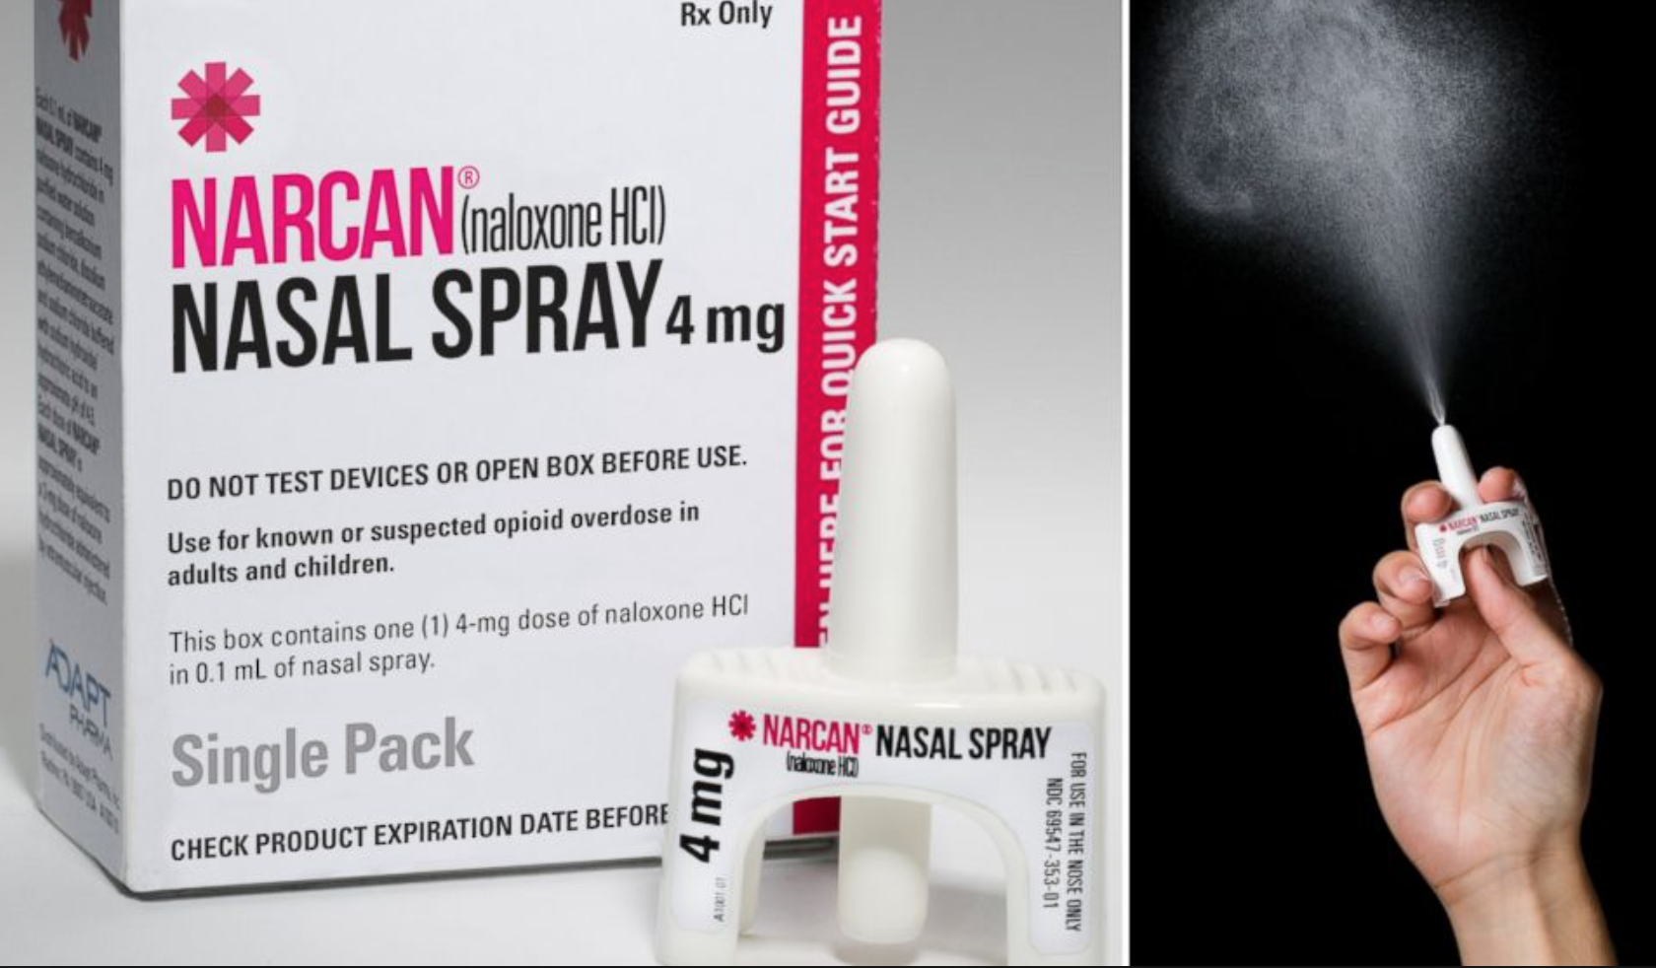
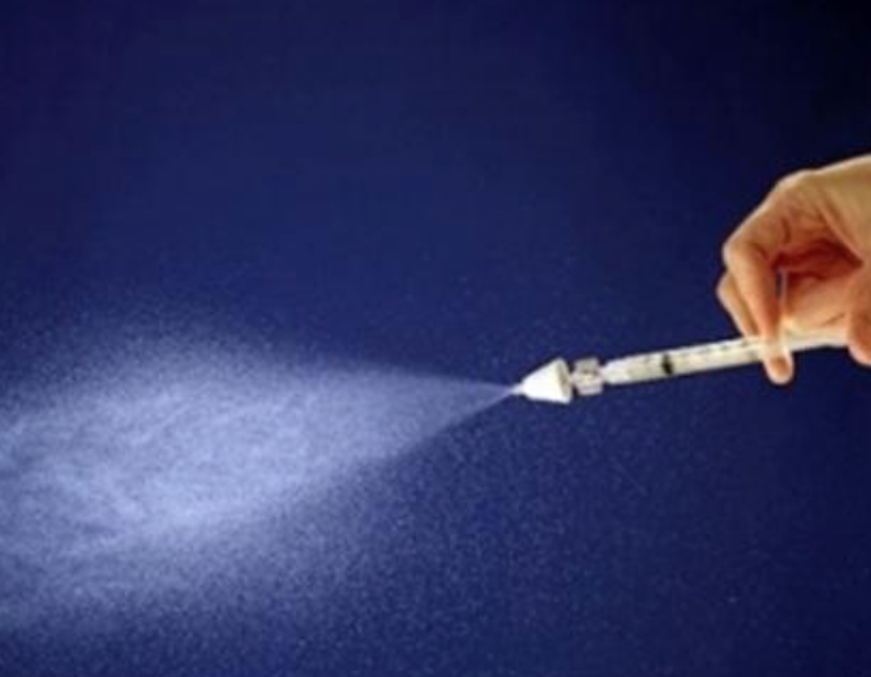
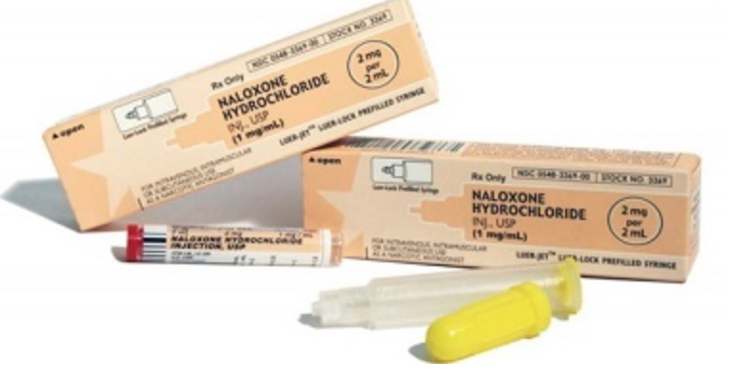
Many pharmacies are offering Narcan kits without a prescription
Notes:
FDA approved IN narcan in many states across the country in 2015; great public health move towards combating the opioid crisis

Slide 20
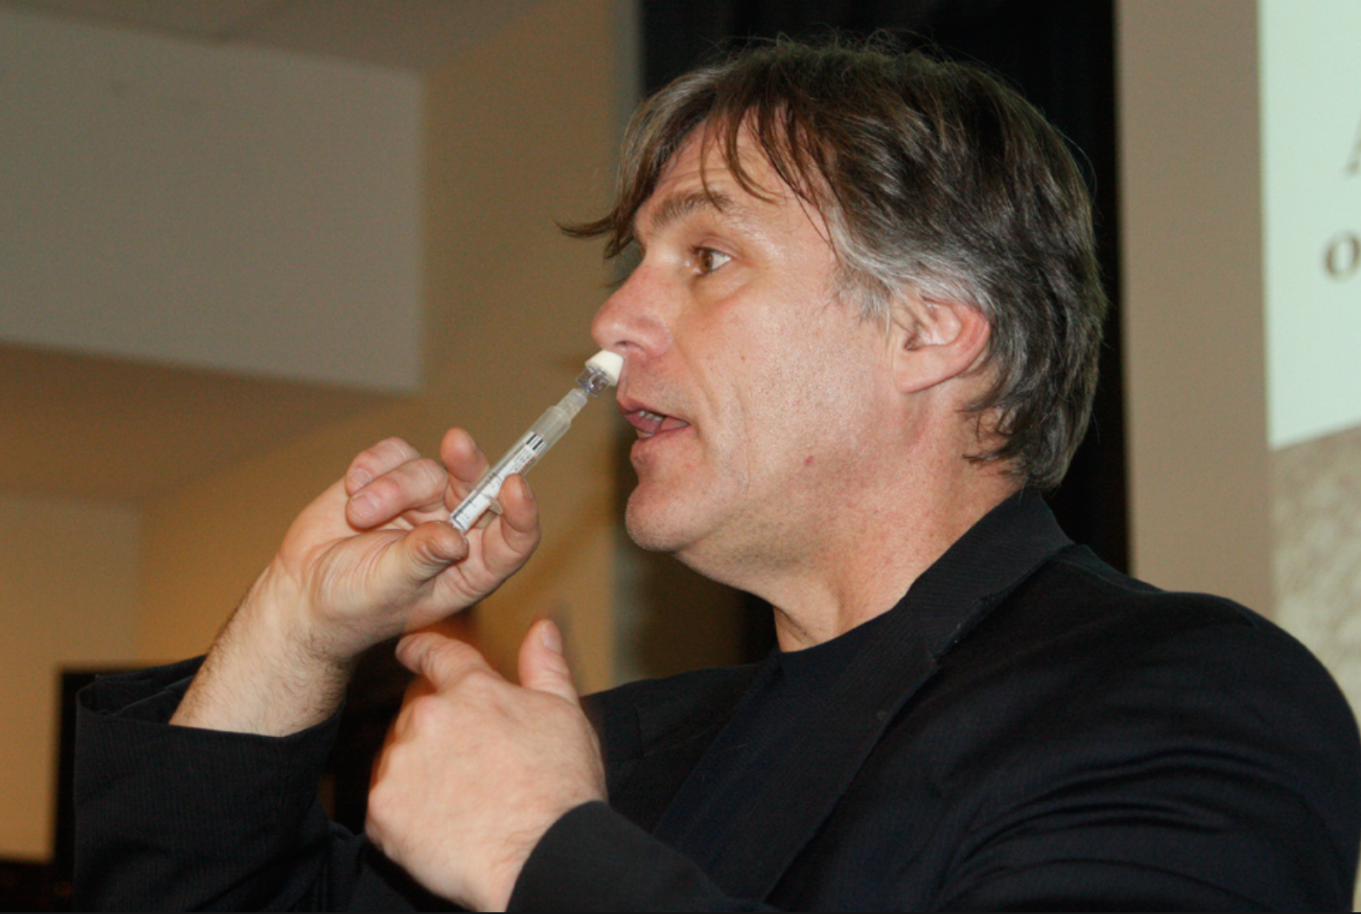
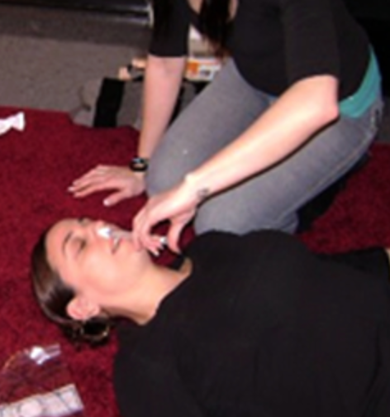
Easy to Use

Slide 21
Chronic use of opioids
The data to support the safety and efficacy of opioids for the management of chronic pain are limited.
Hyperalgesia
Heightened sensitivity to pain
Associated with chronic use of opioids
May be development of tolerance or the need for increased amount of opioid to maintain analgesia
Treatment = attempts at alternative modalities of pain relief
Opioids. Goldfranks Toxicological Emergencies, 10th Ed. 2015.

Slide 22
Excludes active cancer, palliative care, end-of-life care
Chronic pain
Typically lasts > 3 months
Or past the time or normal tissue healing
Based on 3 major principles
Opioids are not first line treatment.
Start low, go slow.
Use caution and monitor.

Slide 23
CDC Key Recommendations
Non-pharmacologic & Non-opioid pharmacologic therapy are preferred for chronic pain.
Cognitive behavioral therapy, exercise therapy, interventional treatments (trigger point injections)
APAP, NSAIDs, antidepressants, anticonvulsants
Avoid extended-release/long-acting preparations
Avoid dual therapy with benzodiazepine
Consider offering naloxone

Slide 24
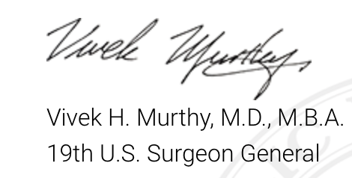
Letter from the Surgeon General
We often struggle to balance reducing our patients’ pain with increasing their risk of opioid addiction. But, as clinicians, we have the unique power to end this epidemic.
Notes:
By recognizing the lack of data to support the use of opioids in the treatment of chronic pain.
And the need to use opioids for acute pain.

Slide 25
HCAHPS
Hospital Consumer Assessment of Healthcare Providers and Systems
Measuring patient satisfaction began 2002
Publically reported
HCAHPS survey implemented by CMS in 2006
Financial incentives – VBP 2012
Notes:
Hospital Consumer Assessment of Healthcare Providers and Systems
Pain assessment became a science.
Chronic pain
> 3 months OR past time of normal tissue healing
Did the # of patients increase?

Slide 26
HHS response
The agency aims to remove even the perception that there is financial pressure on hospitals to overprescribe opioids.
July 2016.

Slide 27
Opioids can provide short-term benefits for moderate to severe pain.
Scientific evidence is lacking for the benefits of opioids to treat chronic pain.
In general, do not prescribe opioids as the first-line treatment for chronic pain.

Slide 28
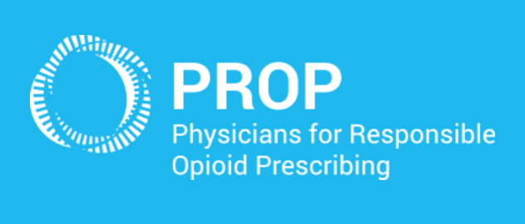
Mission
To reduce opioid-related morbidity and mortality by promoting cautious and responsible prescribing practices.
Prescriber education: many underestimate the risks and overestimate effectiveness.
Consumer education: access to accurate information
Advocacy: policies that promote more cautious prescribing practices

Slide 29
Data on pharmacy dispensed controlled substance prescriptions
As of 2014, 49 states passed legislation authorizing PDMP
Help identify:
Drug diversion (prescription fraud)
Forgeries
Doctor shopping
Improper prescribing and dispensing
Website:http://www.pdmpexcellence.org. Accessed: June 6, 2016.
Notes:
Doctor shopping = 5 or more prescribers in 90 days, OR 5 or more pharmacies in 90 days
mandated in NJ by Oct 2015; but excludes ER docs

Slide 30
Evidence for Effectiveness of PDMPs
Improve clinical decision making and pt care
Confirm assessment of drug-seeking behavior
Help identify abusers
Identifying and reducing doctor shopping
Arkansas: decrease from 114 to 31 within 1 year
Impact on controlled substance availability and prescribing
Florida: 24% decrease in oxycodone Rx
Improved healthcare outcomes
Florida: deaths attributable to oxycodone fell 41% from 2011 to 2012
Website:http://www.pdmpexcellence.org. Accessed: June 6, 2016.
Notes:
doctor shopping: >7 doctors or pharmacies in 90 day period

Slide 31
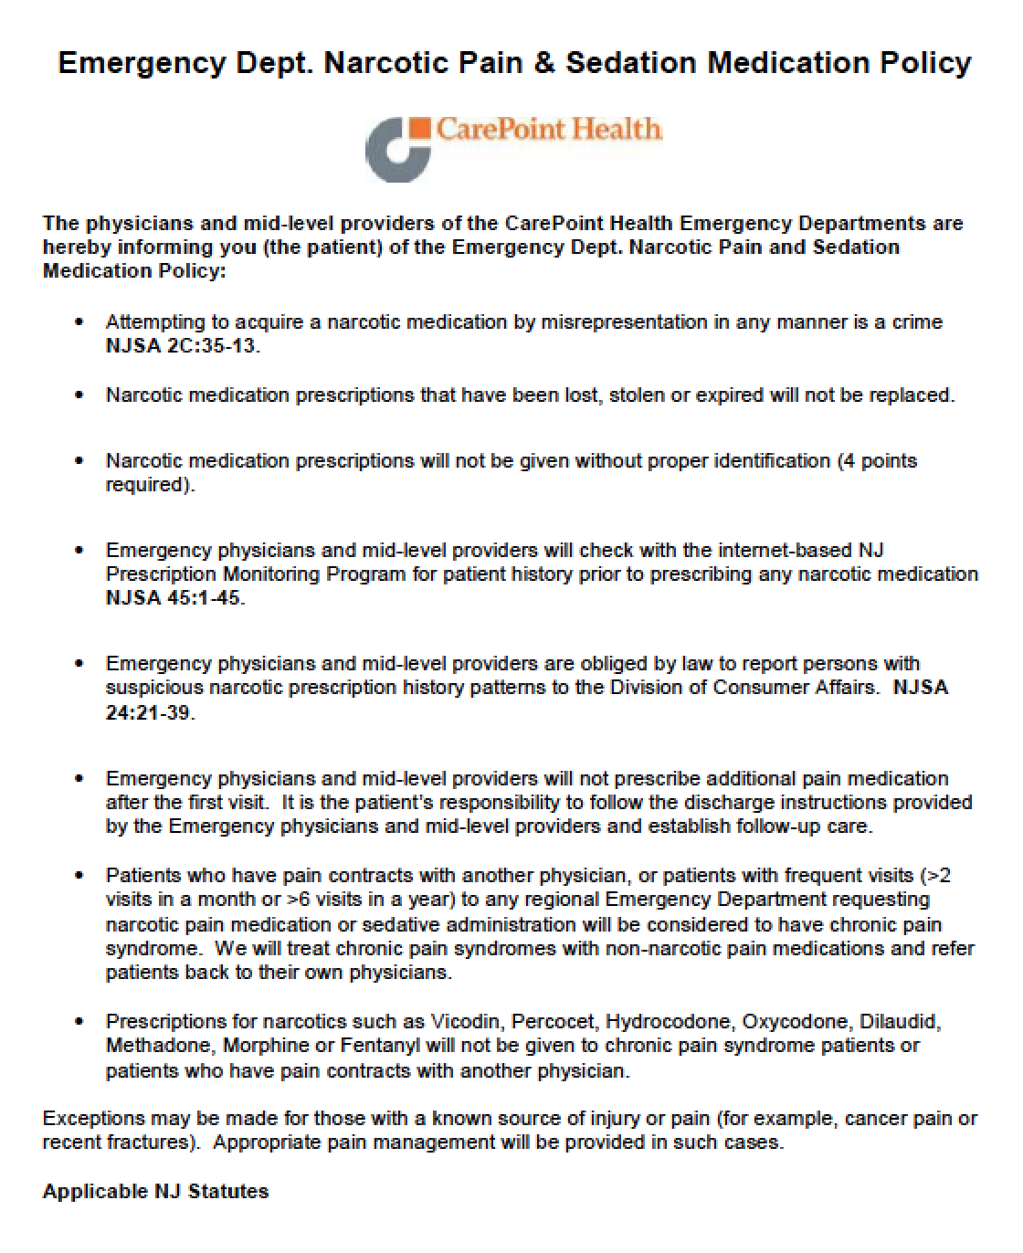
Pain and Sedative Medication Guidelines for the Treatment of Chronic Pain in the ED
Policy:
Supports providers’ decision to limit or deny narcotic medication to chronic pain patient.
Aligned with NJ statutes.

Slide 32
Pain and Sedative Medication Guidelines for the Treatment of Chronic Pain in the ED
Policy
Proper ID may be required
Register for NJ PMP
Not obligated to replace lost, expired, or stolen Rx
Assessment for medical necessity of narcotic Rx
Letters or written orders from PMD will not be honored – direct, real-time communication is required
Pain management consults can be obtained

Slide 33
Feedback from ED Policy
Some patients surprised at direct approach
Manipulative patterns decreased
ED providers and staff feel empowered to do the right thing; they have back-up
Less patients requesting narcotics

Slide 34
ALternatives To Opioids (ALTOSM)
Notes:
1st ED in the nation to adopt an alternative pain mgmt program.

Slide 35
The ALTOSM Program
1st ED in the country to adopt an alternative pain management program
Multi-modal, non-opioid approach to specific diagnoses
Goals
Opioids are second-line treatment
Discuss realistic pain management goals
Discuss opioid addiction potential & side effects

Slide 36
ALTOSM Approach
Non-opioid pharmacotherapy
Ketamine, nitrous oxide, APAP, NSAIDs, lidocaine, steroids, gabapentin, valproic acid
Non-pharmacotherapy
Trigger point injection, rest/ice/elevation
Conditions
Renal colic
Lumbar radiculopathy, acute on chronic
Acute headache/migraine
Musculoskeletal pain
Extremity fracture/joint dislocation

Slide 37
Summary of Clinical Approach
Scientific evidence is lacking for the benefits of opioids to treat chronic pain.
Discuss the significant risks of addiction.
As clinicians, we have the unique power to end this epidemic.

Slide 38
Thank you

