Slide 1


U.S. Drug Enforcement Administration
Tactical Diversion Squad
New Jersey Division

Slide 2
Prescription Drug Abuse
Prescription drug abuse is the fastest growing drug problem in the United States
More Americans abuse prescription drugs than the number of:
Cocaine, Hallucinogen, Methamphetamine &
Heroin abusers
COMBINED!!

Slide 3

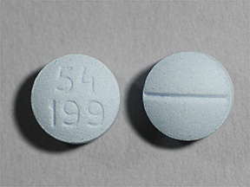
Oxycodone
OxyContin ©
Originally developed to treat pain relief for
cancer patients
Opiods are used for immediate pain relief
Are the most commonly diverted pills into the Black Market
Average prescription written is for 120-180 pills
Street Value for 30mg: Ranges from $15-30 per pill
Oxycodone

Slide 4
New Jersey State Overview
Ranks 11th in the U.S. with population of 8.8 million documented inhabitants
21 counties
Total square mileage: 8,722
Ranks #1 by population density with average of 1,205 people per square mile
46,185 DEA Registrants
  Physicians, hospitals, pharmacies, narcotic treatment programs, distributors, manufactures, importers, exporters, etc
  190,538 registrants for every New Jersey documented resident
Source: 2011 United States Census Bureau
2013 U.S. Census Bureau-Population Division

Slide 5
New Jersey v U.S. Statistics
Since 2007 New Jersey has seen the drug overdose rate increase 71%
75% of this has been caused by pharmaceutical opiate and/or opiate and other drug combinations
Average age group remains in the 18-25 year-old range
Experimentation and addictions are beginning at age 12
New Jersey’s population accounts for 3% of the U.S.’s population
Latest obtainable statistics report during 2010-2011 (combined), rate of non-medical prescription pain relievers and pharm drug abuse among those age 12 and older was 4.6% nationally
Same time frame and age range in New Jersey rated at 4.14%

Slide 6
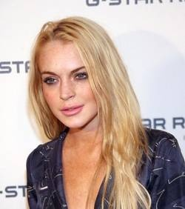
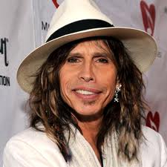
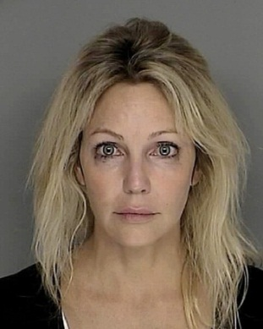
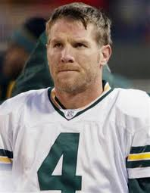
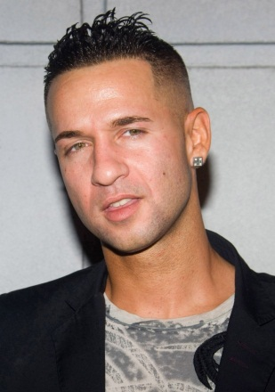
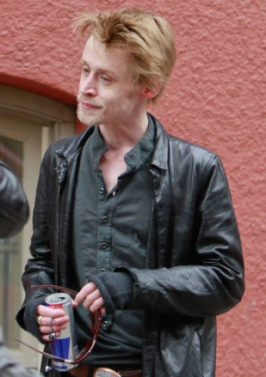
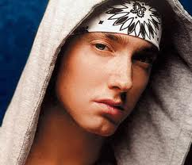
Steven Tyler
Lindsay Lohan
Heather Locklear
ABUSERS
Brett Farve
The Situation
Eminem
Macaulay Culkin

Slide 7
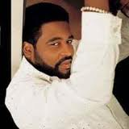
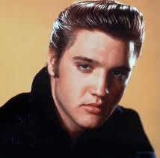
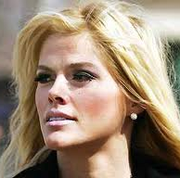
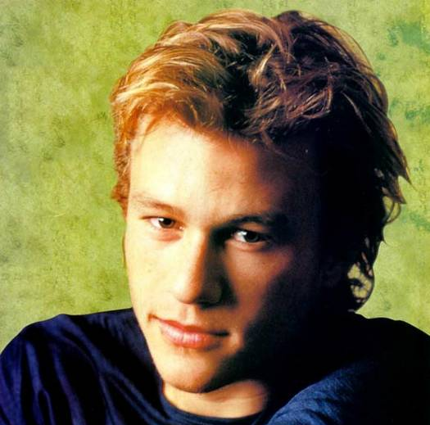
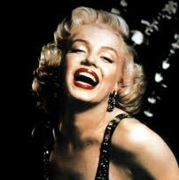
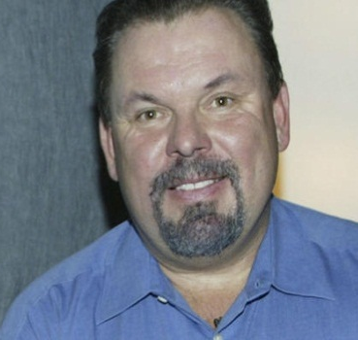
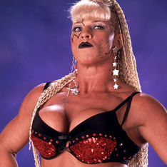
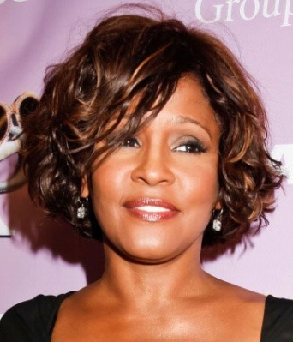
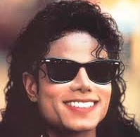
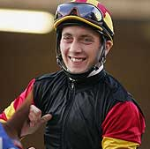
Overdose
Deaths
Gerald Levert
November 10, 2006
Elvis Presley
August 16, 1977
Anna Nicole Smith
February 8, 2007
Heath Ledger
January 22, 2008
Marilyn Monroe
August 5, 1962
Thomas Kinkade
April 6, 2012
Luna Vachon
August 27, 2010
Whitney Houston
February 11, 2012
Michael Jackson
June 25, 2009
Michael Baze
May 10, 2011

Slide 8
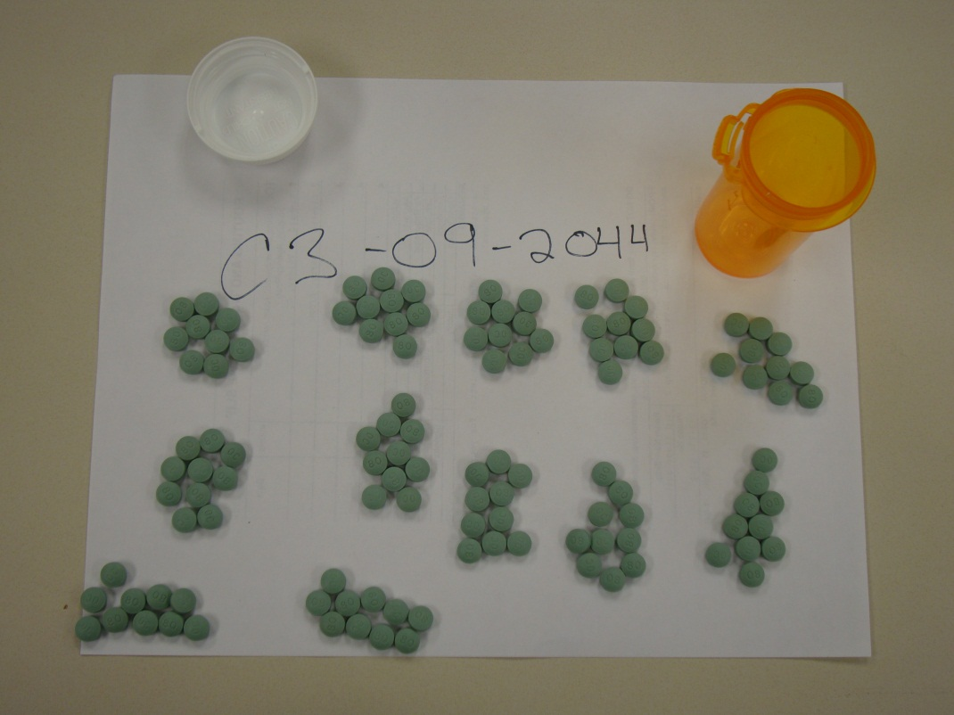
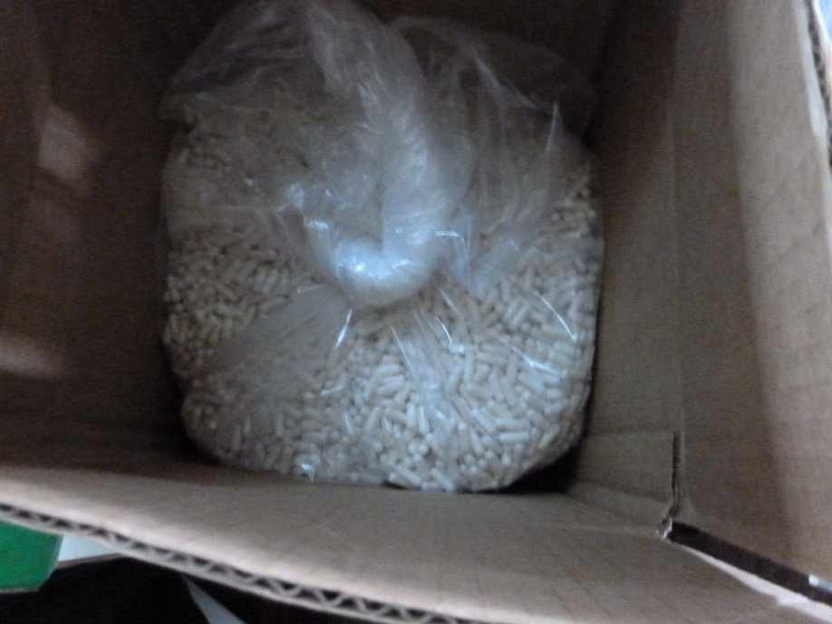
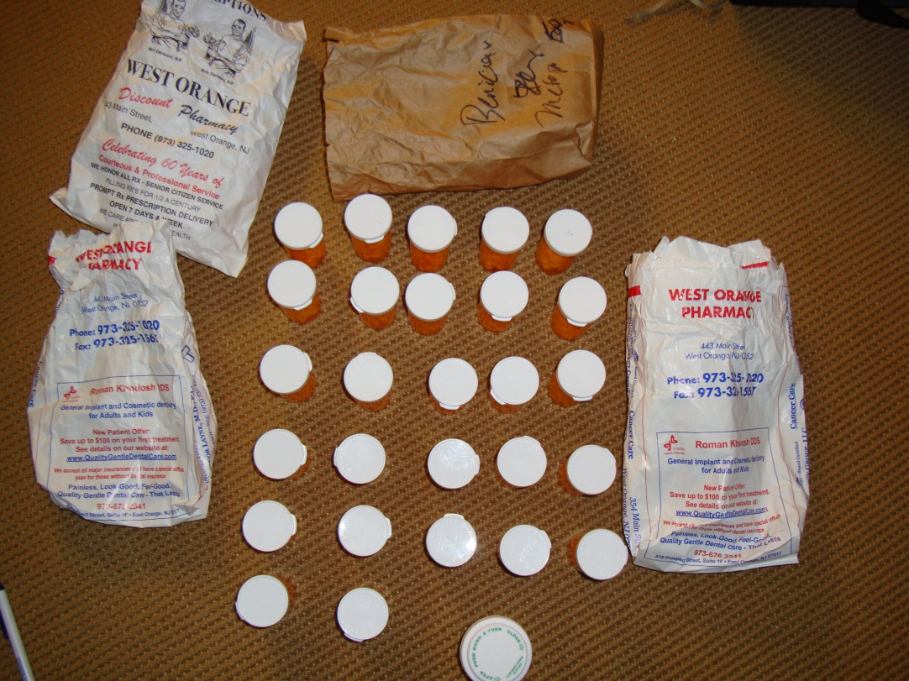
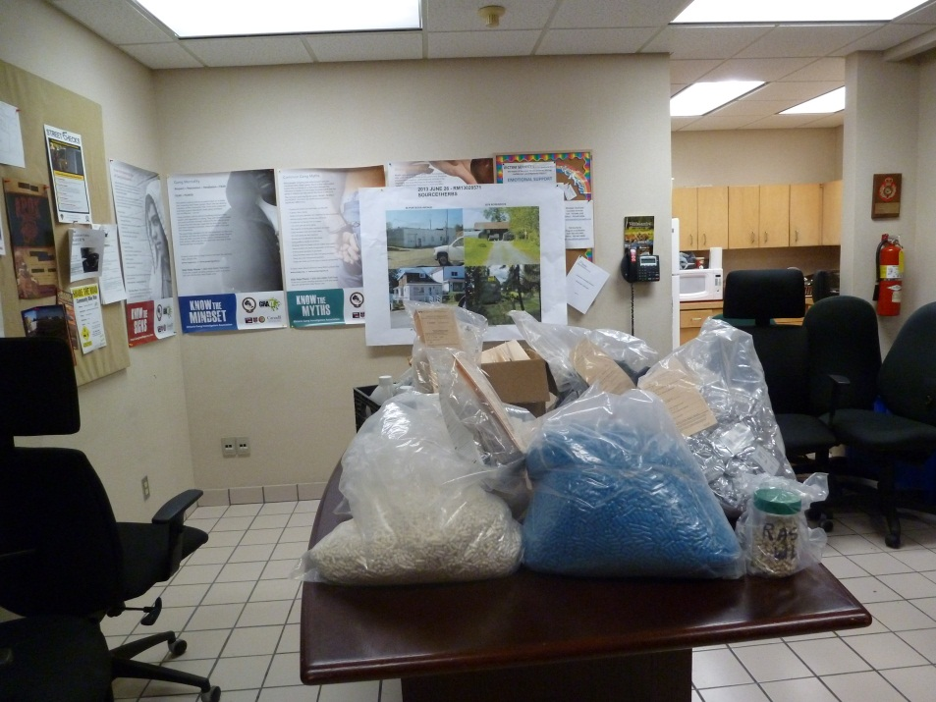

Slide 9
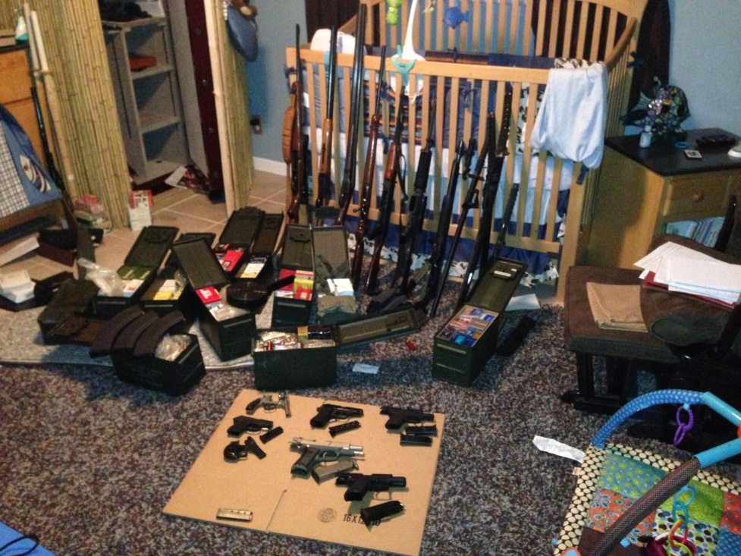
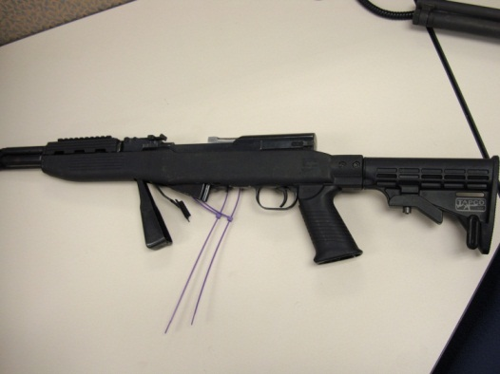
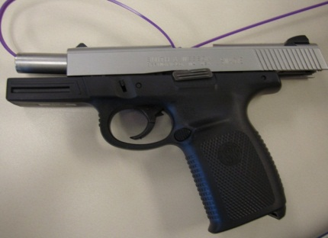
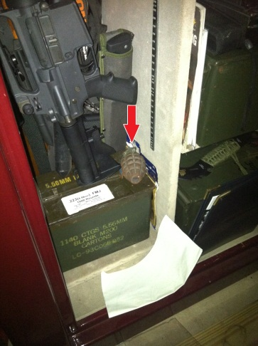
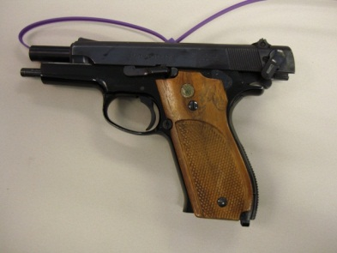
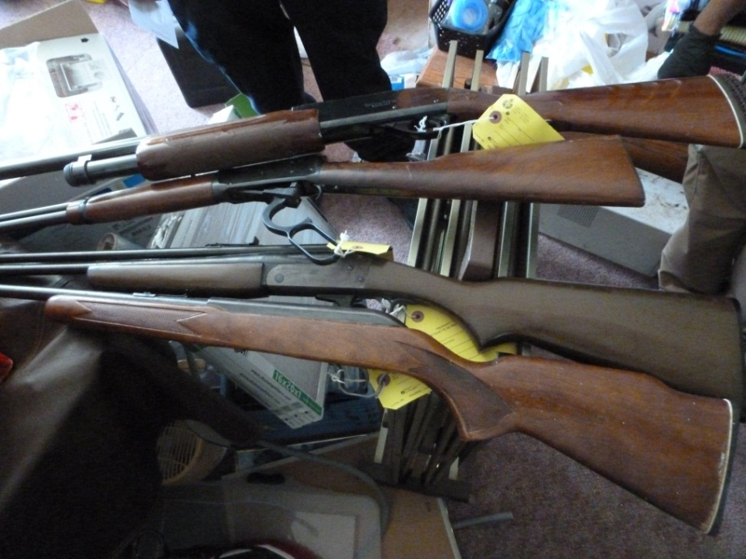
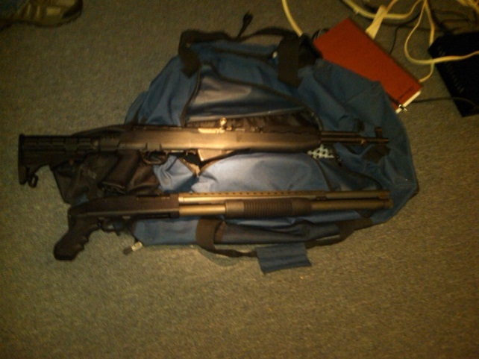

Slide 10
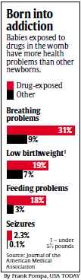
Addicted Infants Triple in a Decade
USA Today: May 1, 2012

Slide 11
Prescription Drug Abuse
(Societal Issue)
In an article by CBS Atlanta (2013), the Mayo Clinic has reported that nearly 70% of Americans are taking at least one prescription drug
More than 50% are on at least two prescriptions
20% are on at least five prescription drugs.

Slide 12
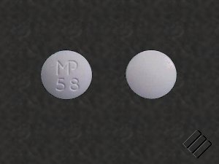
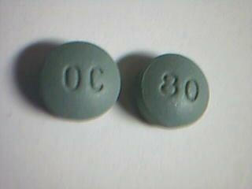
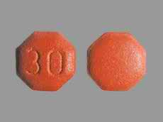
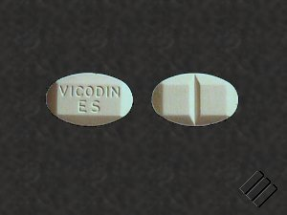
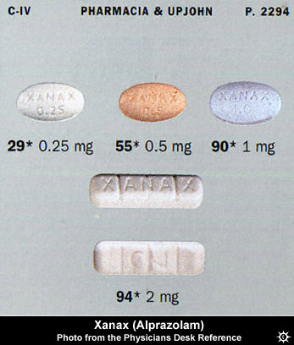
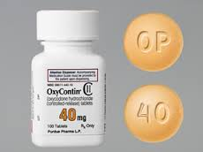
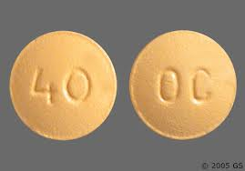
Commonly Abused Controlled
Pharmaceuticals
Carisoprodol
C-IV as of 1/11/2012
OxyContin© 80mg
Oxymorphone
Hydrocodone
Oxycodone 30 mg
Alprazolam
(Xanax)
OxyContin© 40 mg

Slide 13
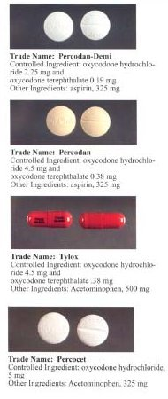
Other Oxycodone Products
Roxicodone
Percocet
Percodan
Tylox

Slide 14
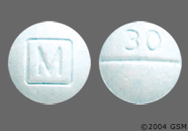
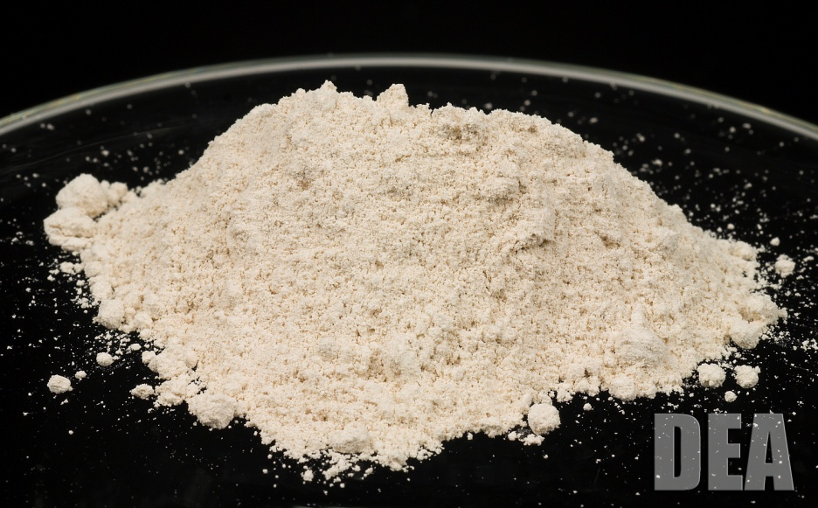
Trend
Oxycodone 30mg
Heroin
Street Value as High as
$30 per pill
Street Value approximately
$55 a gram
(equivalent to over
33 oxycodone pills)

Slide 15

Oxycodone v. Heroin
The new “gateway drug”

Slide 16
Circle of Addiction & the Next Generation
Oxycodone Combinations
Percocet®
$7-$10/tab
OxyContin®
$80/tab
Hydrocodone
Lorcet®
$5-$7/tab
Roxicodone®
Oxycodone IR 15mg, 30mg
$30-$40/tab
Heroin
$15/bag

Slide 17
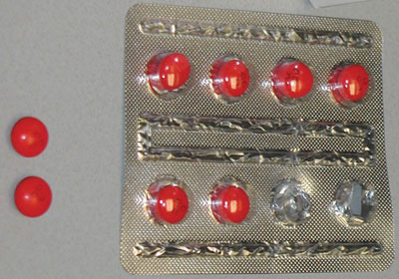
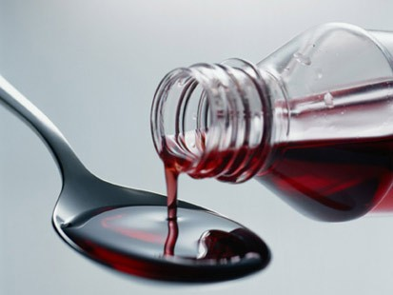
Dextromethorphan (DXM)
Cough suppressant in over 125 OTC medications (e.g., Robitussin and Coricidin)
Bulk form on the Internet
At high doses, has Ketamine- and PCP-like effects
Produces physical and psychological dependence
Deaths associated with DXM abuse

Slide 18
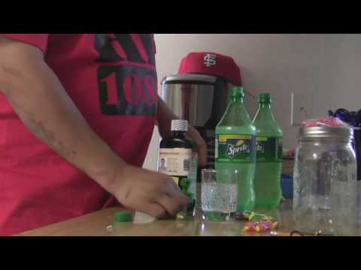
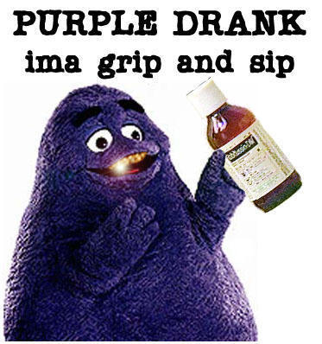
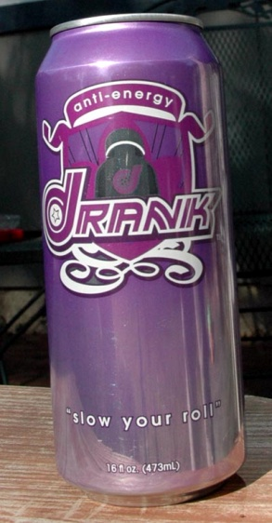
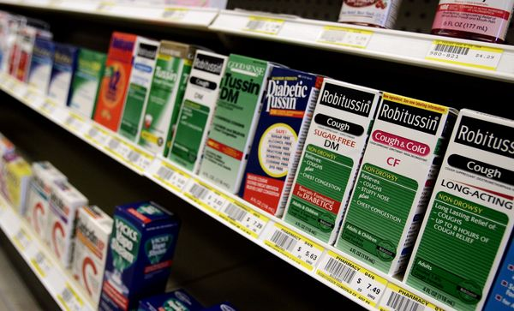
Cough Syrup Cocktails
“Syrup and Soda”
“Seven and Syrup”
“Purple Drank”

Slide 19
Where People are getting
their drugs???

Slide 20
Common Methods of Diversion
Pharmacy / Other Theft
  Armed robbery
  Burglary (Night Break-ins)
  In Transit Loss (Hijacking)
  Smurfing
Employee Pilferage
  Hospitals
  Practitioners’ offices
  Nursing homes
  Retail pharmacies
  Manufacturing / distribution facilities
The Internet
Pain Clinics
The Medicine Cabinet
Doctor Shopping
  Drug rings
  Forged / fraudulent / altered prescriptions
Practitioners / Pharmacists
  Illegal distribution
  Self abuse
  Trading drugs for sex

Slide 21
MANUFACTURER
DISTRIBUTOR
PHARMACY
STREET DEALER / ABUSER
$$$$$
Hospital
Physician

Slide 22
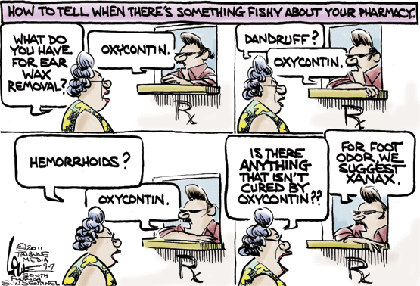

Slide 23
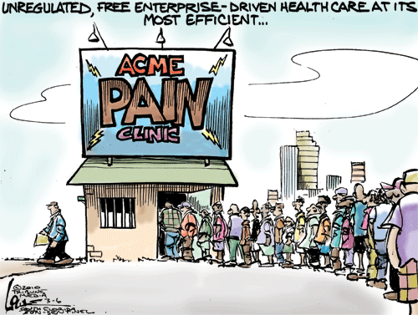

Slide 24
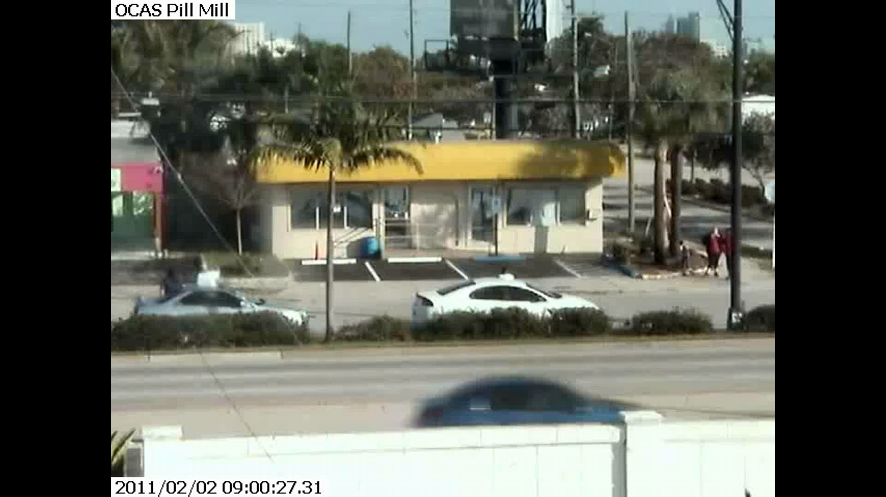

Slide 25

Questions?
Phil Streicher
Group Supervisor
973-776-1243

