Slide 1
Knock Out Opioid Abuse Day
October 6, 2018
Notes:
Welcome and housekeeping info from Greg S.

Slide 2
Knock Out Opioid Abuse Day
A project of the Partnership for a Drug-Free New Jersey and The Community Coalition for a Safe and Healthy Morris, in cooperation with the New Jersey Department of Human Services, and Governor’s Council on Alcoholism and Drug Abuse
Notes:
Angelo will provide and overview of the day, introduce the partners on this project and invite each to introduce themselves. Angelo will then discuss the origins of the idea for this project and as Barbara to speak a little bit about the origins of the day. He will then speak about the outreach and commitment of both DHMAS and GCADA in supporting this outreach.

Slide 3
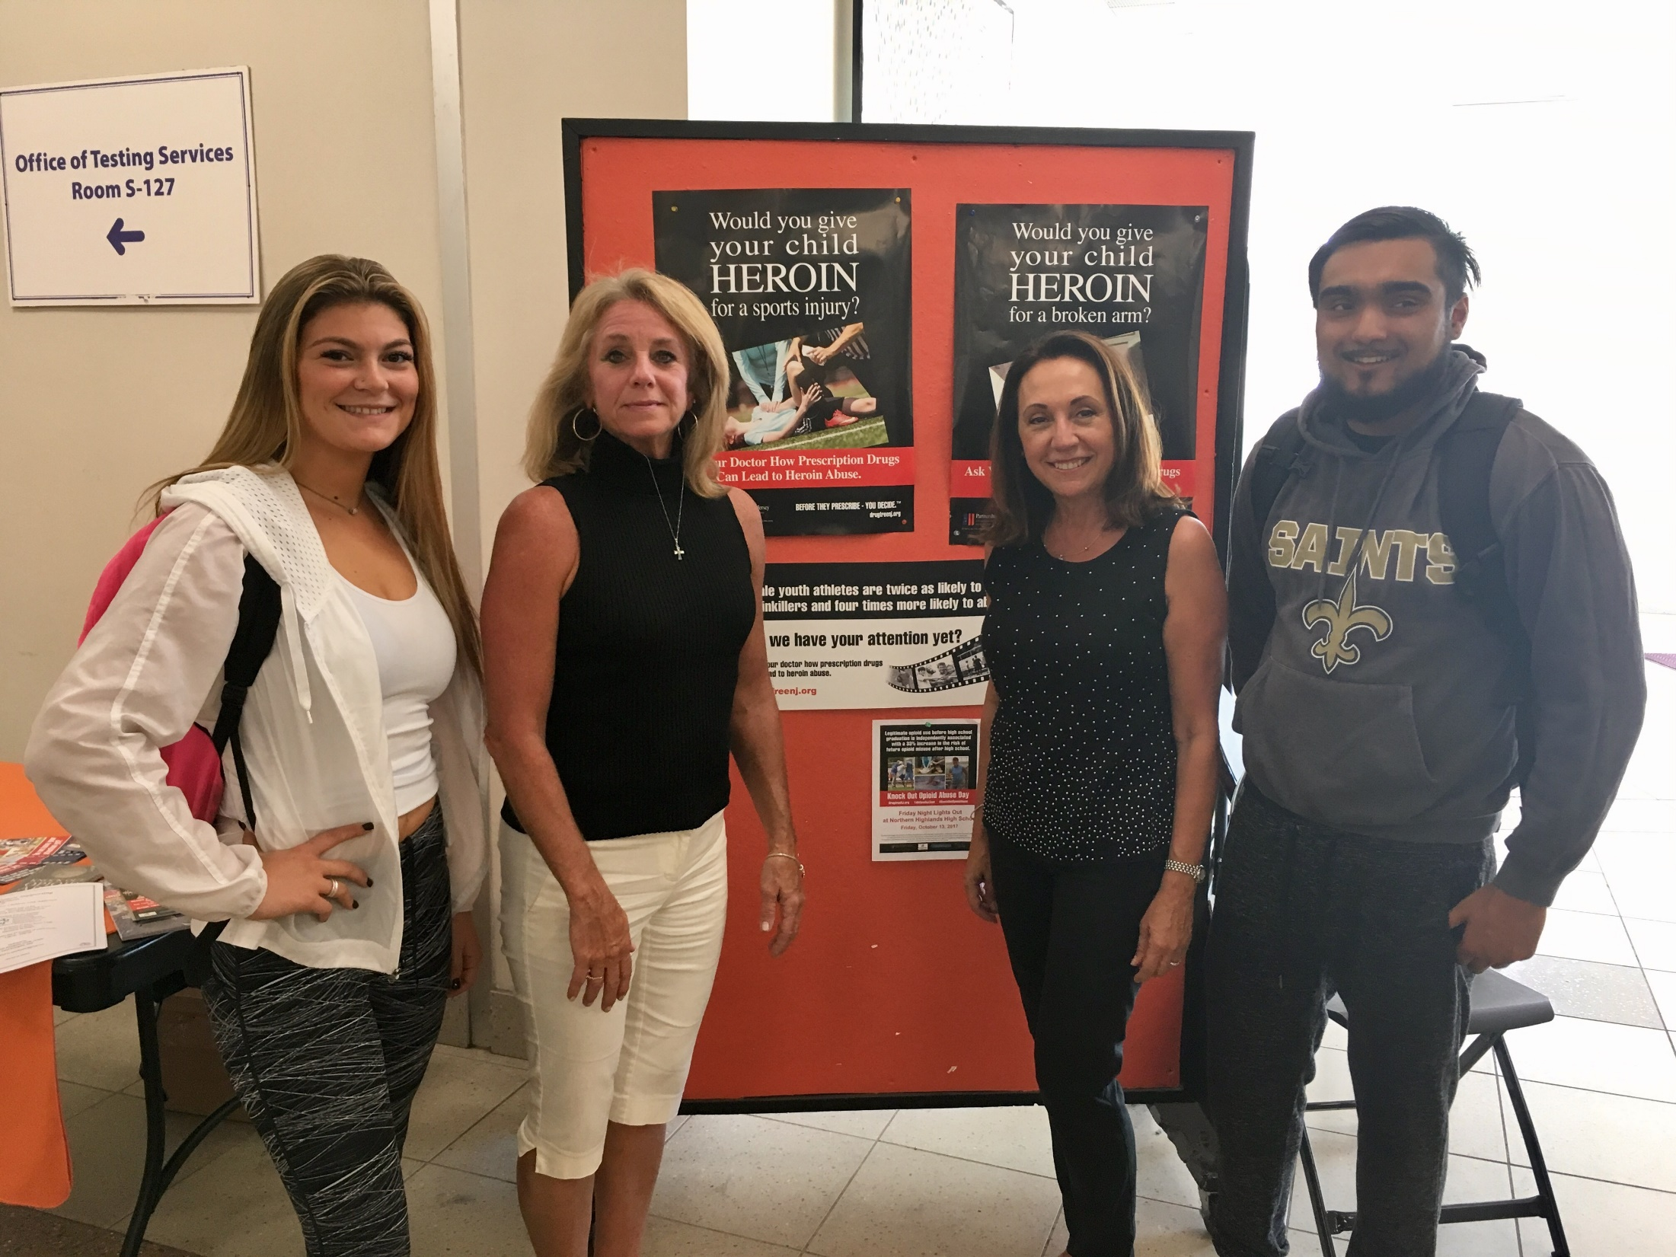
What is it?
October 6, 2018 has been designated Knock Out Opioid Abuse Day in New Jersey.
The statewide single-day initiative will mobilize the prevention and treatment communities, community leaders, and concerned citizens to raise awareness of the potential for dependency on prescribed pain medicine and its link to heroin abuse rates in our state.
The mobilization will have a dual focus: educating physicians and raising awareness among New Jersey citizens and families.
Notes:
Angelo will outline the specifics of the day, and the stats behind getting the information out statewide
According to the CDC, opioid pain relievers that are abused were most often obtained via prescription from physicians. early one in three parents of New Jersey middle school students do not believe there is a link between pain killers prescribed for things like sports injuries and wisdom tooth removal and the rising use of heroin in New Jersey.
The study also found that less than 50 percent of parents feel they are knowledgeable about heroin.

Slide 4
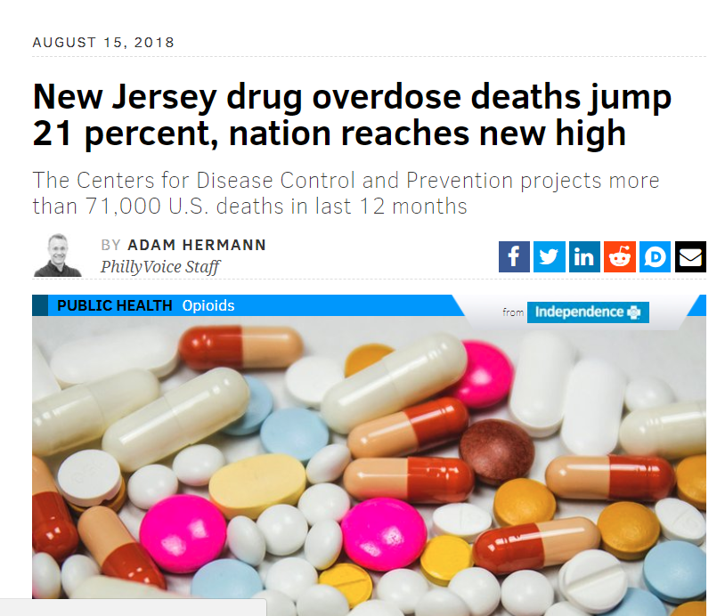
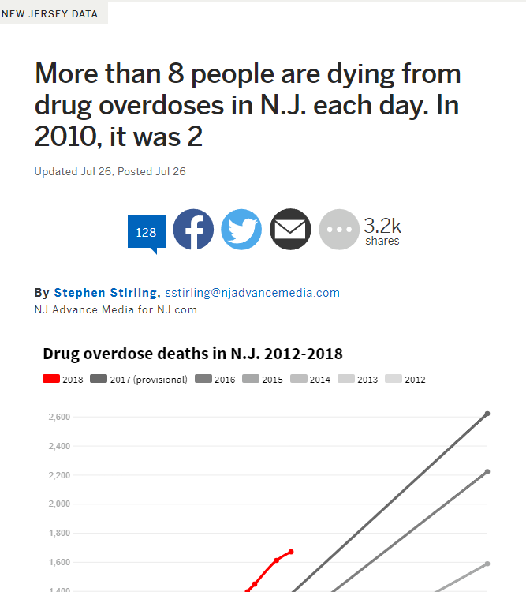
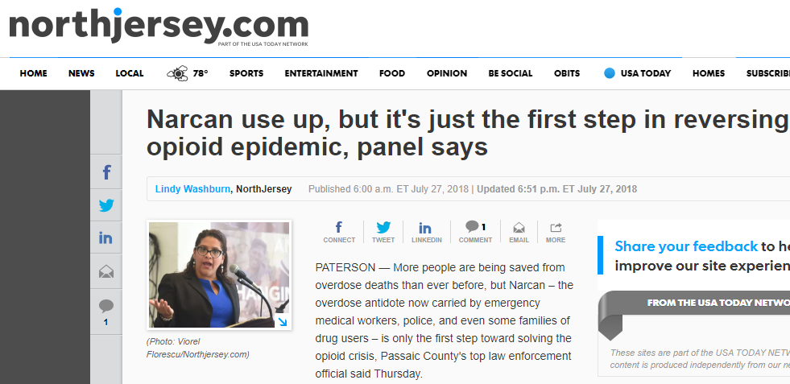
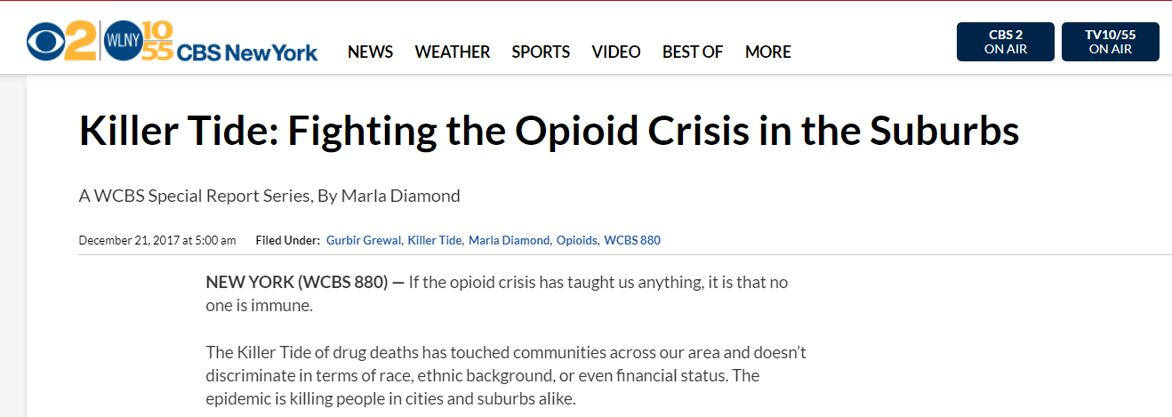
Addressing the Issue

Slide 5
Building on Success..

Slide 6
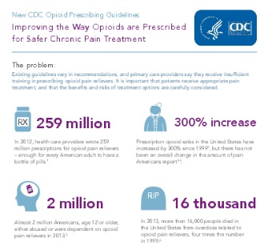
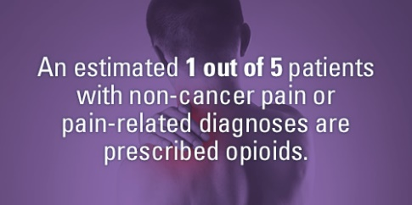

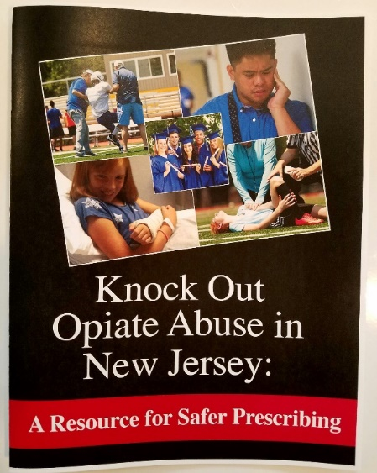
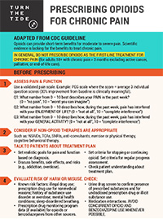
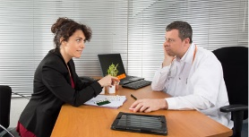
Outreach to Prescribers and Families
Building on Success...
Resource Guides
Turn The Tide Pocket Cards

Slide 7
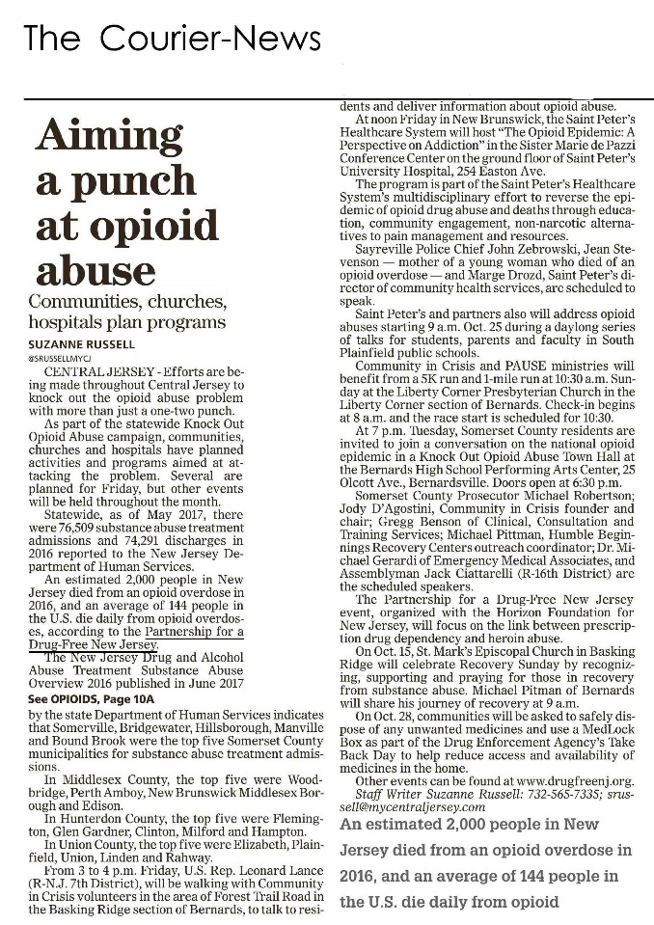
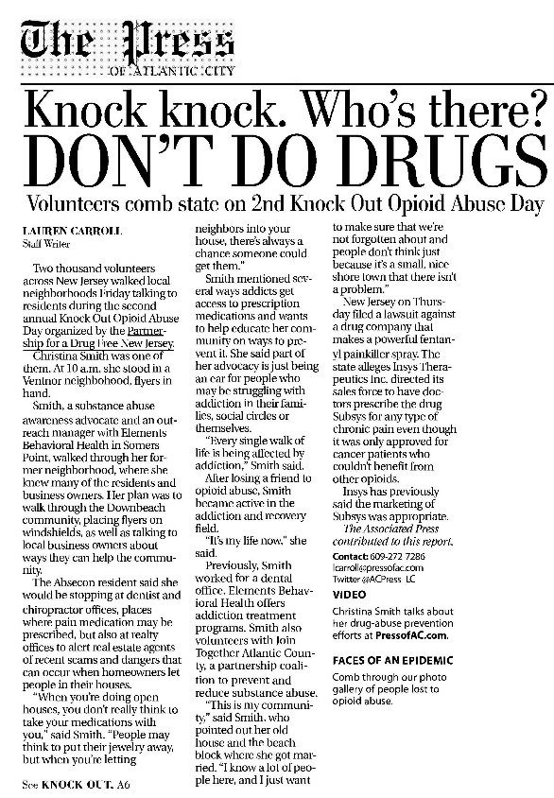
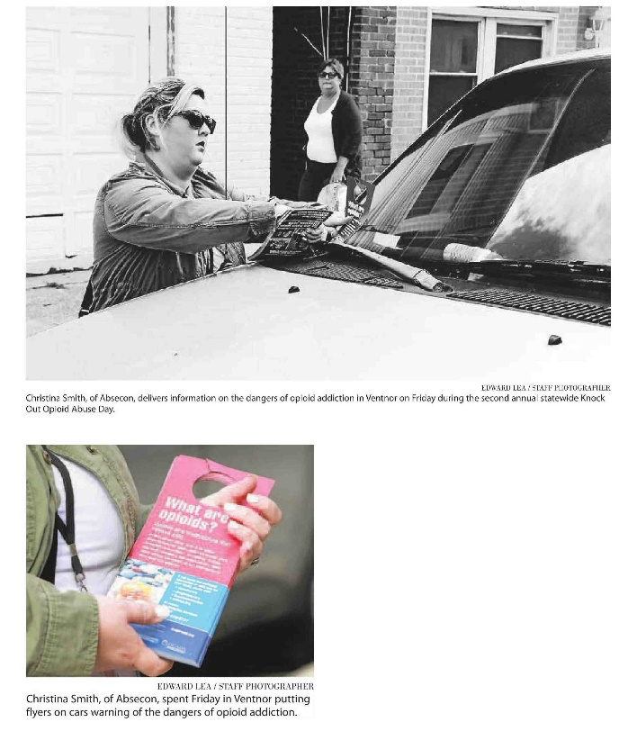
More than 5,000 Volunteers Across NJ
Building on Success...

Slide 8
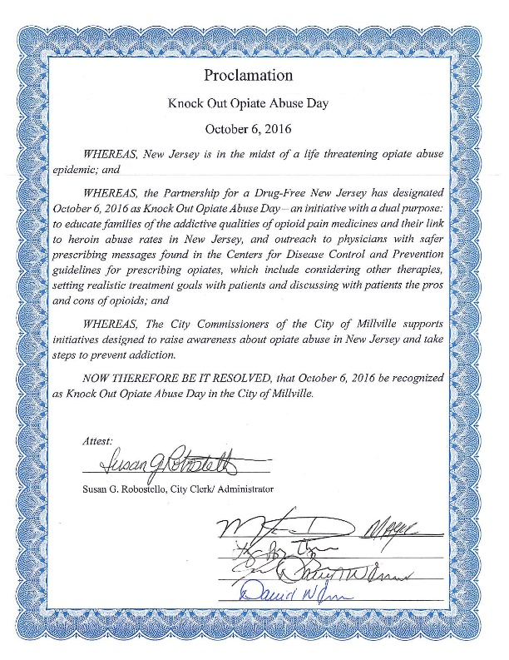
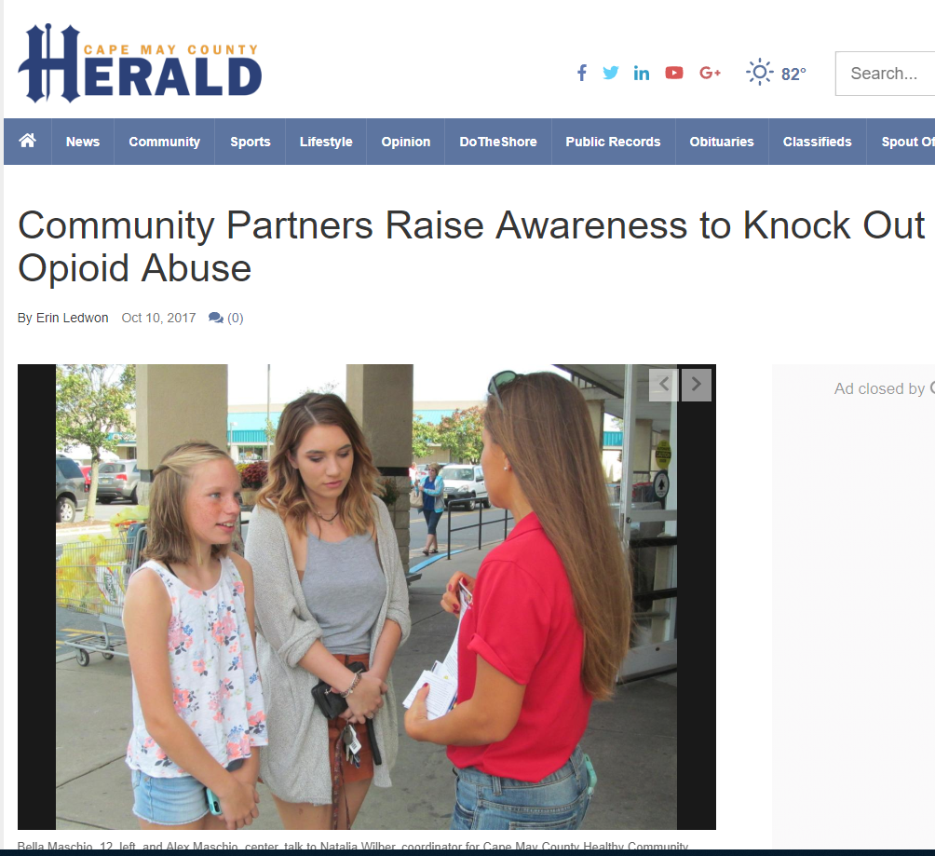
Building on Success...
Senate designation of Annual Knock Out Opioid Abuse Day on October 6thn

Slide 9
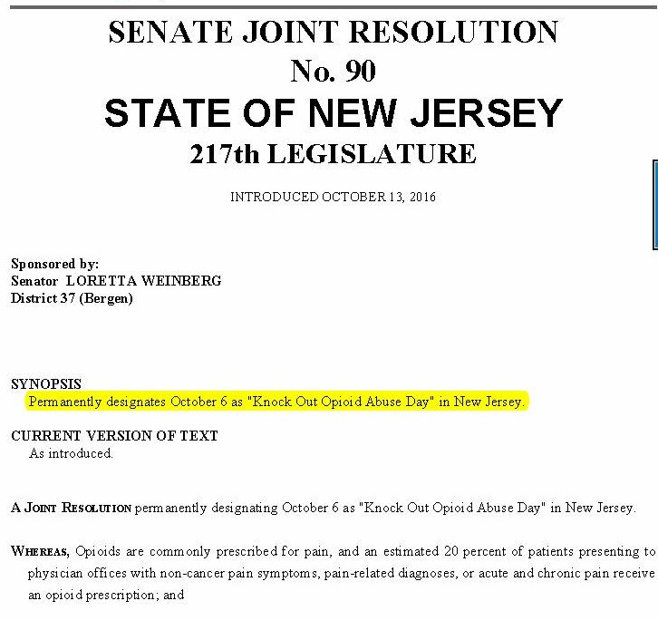
Building on Success...

Slide 10
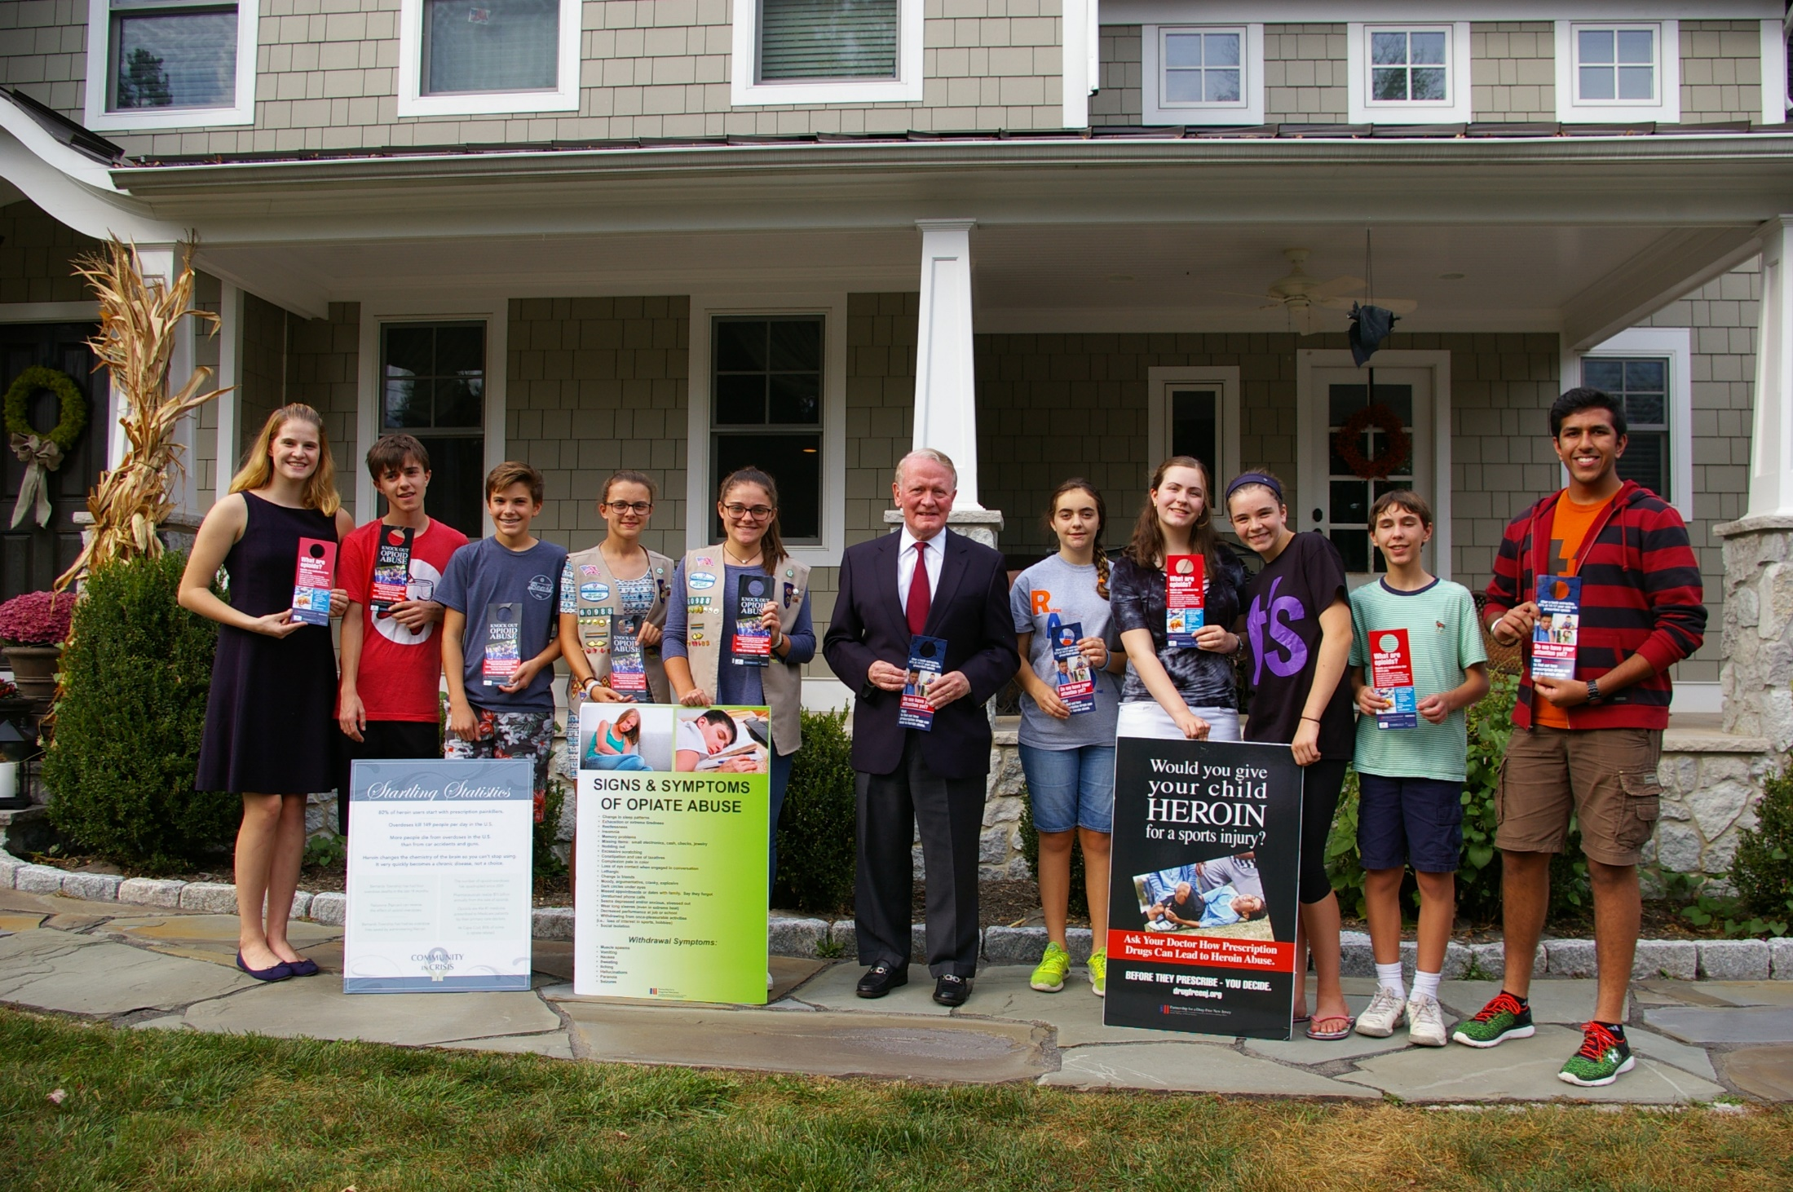
Collaborating for Success
GCADA
DMHAS
Notes:
Rebecca and Don will discuss the role their stakeholders/grant recipients can have in this outreach.
Don will address the shared opportunity for all to participate at the state and county level, as well as any other information he wishes.
Rebecca will talk about the success of this type of outreach, as well as the adherence to municipal alliance plans, and any other information she wishes.
Coalitions
Alliances
Interested volunteers or family members
Recovery Advocates
College Students
High School SADD type groups (for family outreach)
Local politicians
Scouts (for family outreach)
A list of the # of volunteers from each county will be tabulated to inform the press. The goal is a minimum of 100 volunteers per county.

Slide 11






















































Prevention and Education:
A Vital Piece of the Puzzle in NJ.
Notes:
Angelo will transition the conversation to the importance of share the same messages statewide and every single role is important. He will discuss the comparison to pharm salespeople who knock on doors each day to get their message out to physicians and on October 6th the prevention, treatment, recovery communities, as well as many volunteers personally touched by opiate abuse and introduce the message that the volunteers on Knock Out Opiate Abuse day will share.

Slide 12
Messages

Slide 21




2018
New Door Hangers

Slide 22
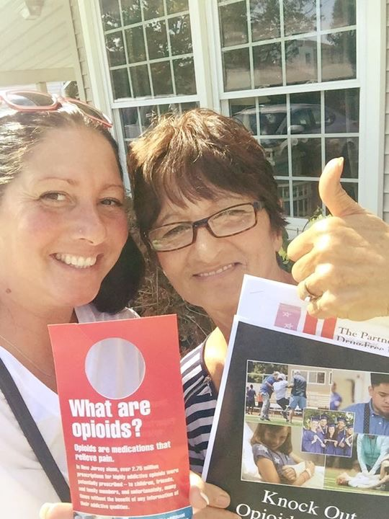

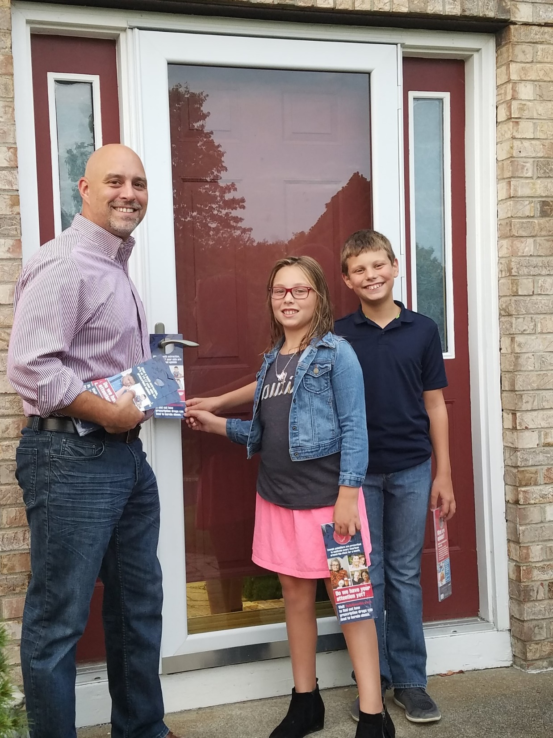
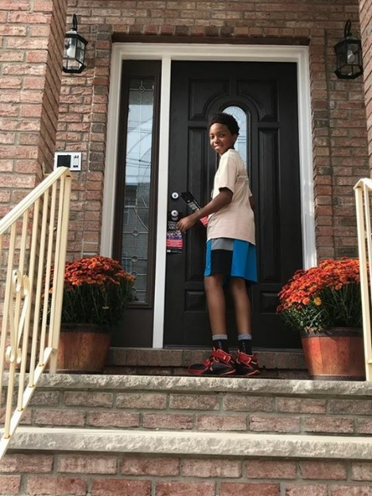
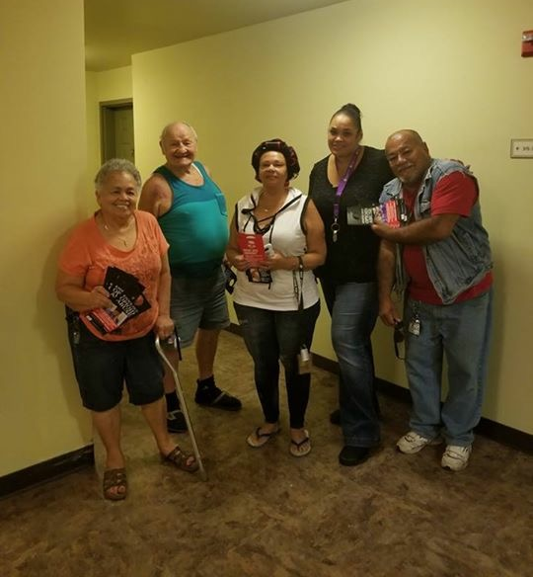
Outreach to Residents and Families
Notes:
Angelo will describe the outreach to families, noting that at the trainings to be held in September, each volunteer coordinator will be provided with door knockers for each of the volunteers in an area to use in their neighborhood/community. Outreach to homes/families can occur any time appropriate for the community on October 6, 2017.
Postcards will be an additional resource for neighborhoods with solicitation/no-knock laws.

Slide 23

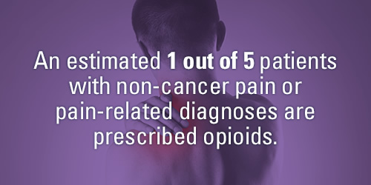
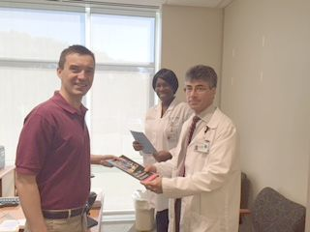
Outreach to Prescribers:
Physicians/Dentists
Notes:
Angelo will discuss the outreach to physicians. Noting that each county leader will receive a list of prescribers – physicians and dentists. Outreach will take place from 10 am to 12 pm and from 2 pm to 4 pm. Volunteers will be provided with a resource guide to leave each prescriber they visit which will include the CDC guidelines, information about sigma reduction, and a sign to display in their location.

Slide 25

Additional Resources..

Slide 26
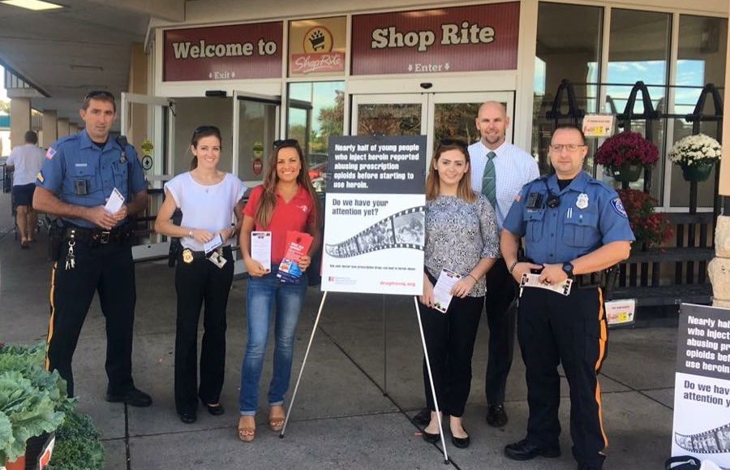
Coordination and Trainings
County Teams
Outreach: Media and Prescriber List
In Person Trainings:
  September 12th: Morris County
  September ?? : Burlington County?
Notes:
Anyone interested in being a team leader in their County should follow the instructions they will receive in the post Webinar email.
PDFNJ will coordinate the outreach on the day of the event to the media and will provide the prescriber list to each team leader
Trainings outlining these details will be open to all volunteers on August 15th and 30th from 7 pm to 9 pm. They will include an overview of the epidemic and outreach initiative, and material distribution.
Barbara will discuss the Focus on celebrity door knockers which will generate interest and publicity. Information on how to suggest a local celebrity will be included in the post webinar email.

Slide 27
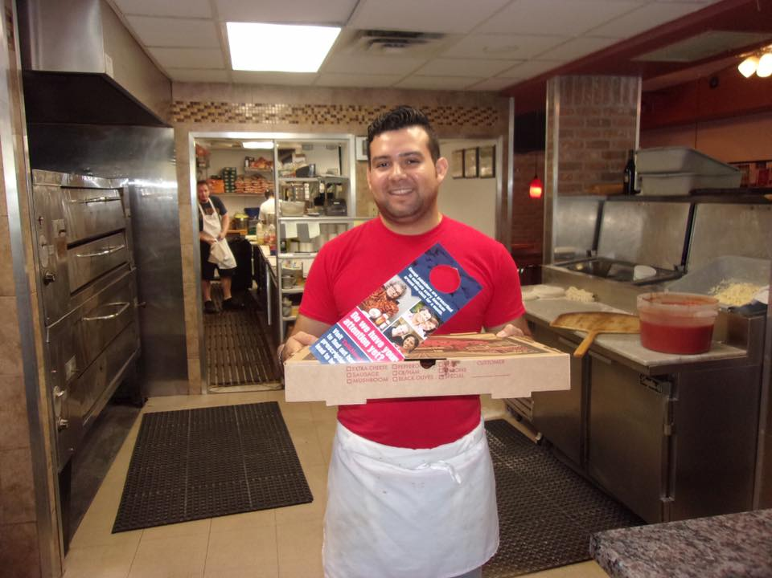
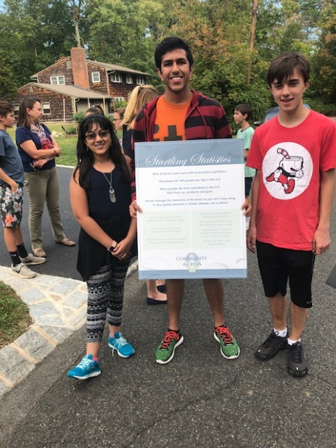
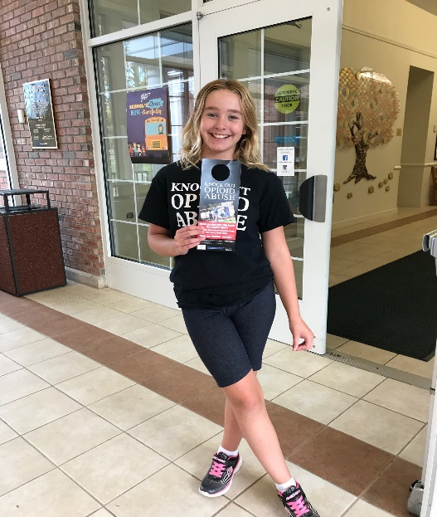
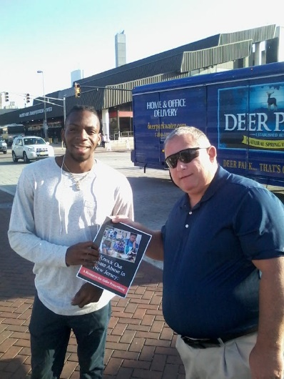
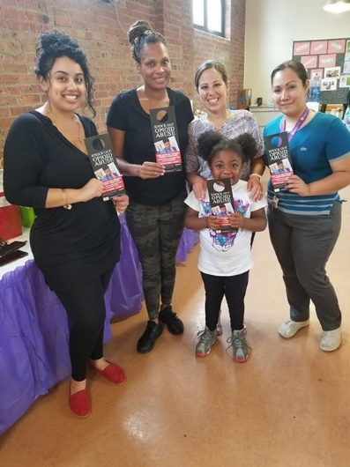
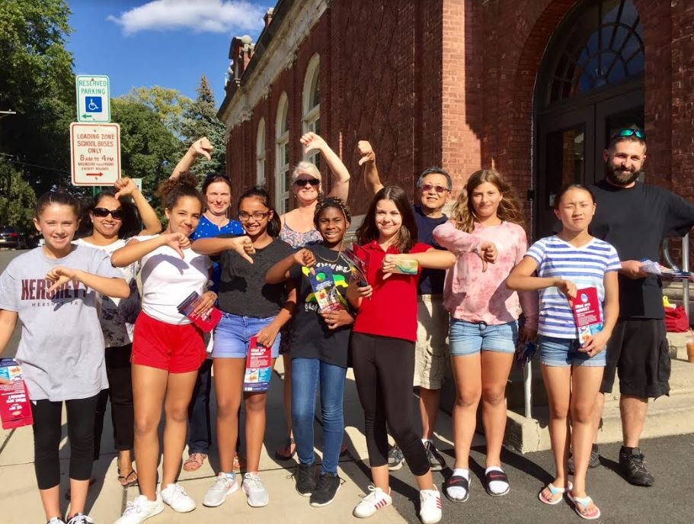
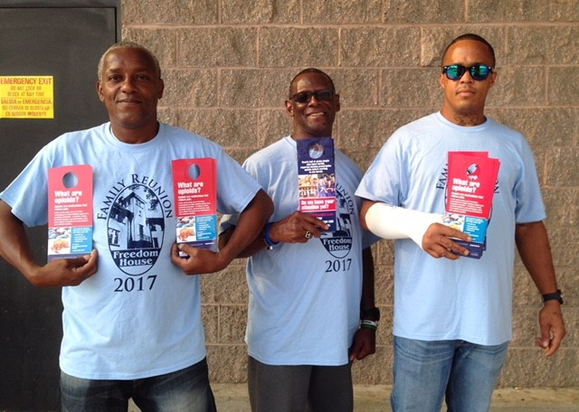
Our 2017 Supporters

Slide 28
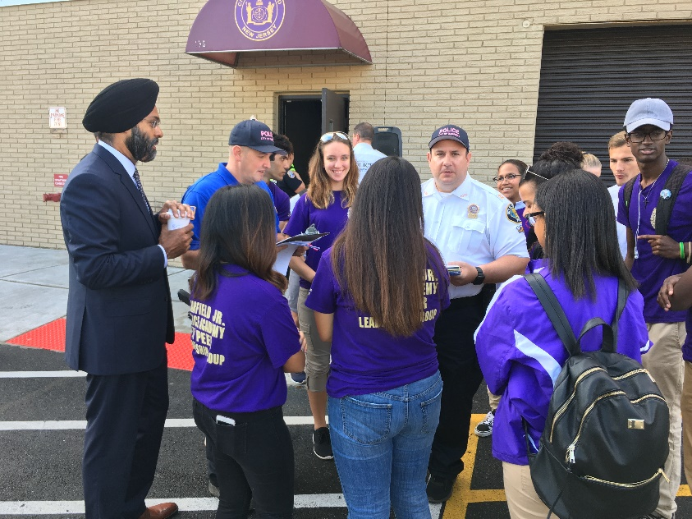
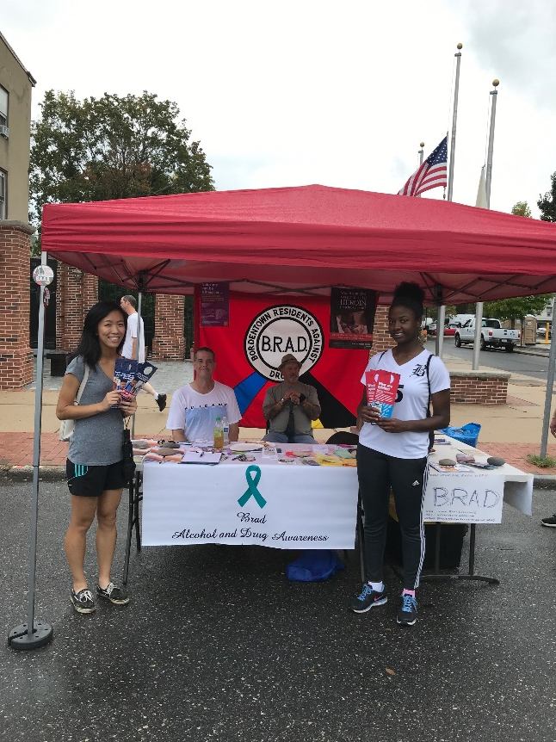
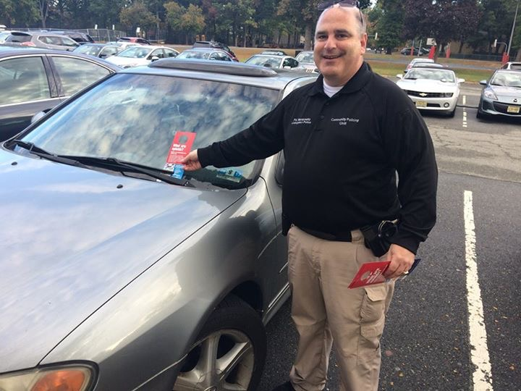
Success Strategies

Slide 29
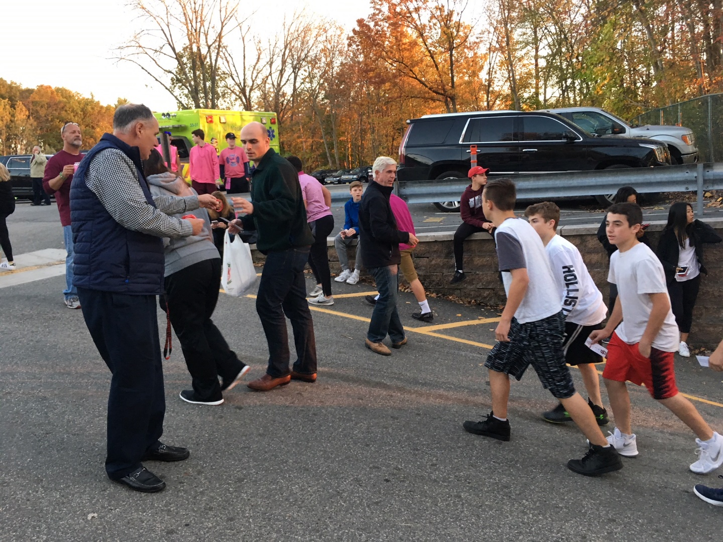
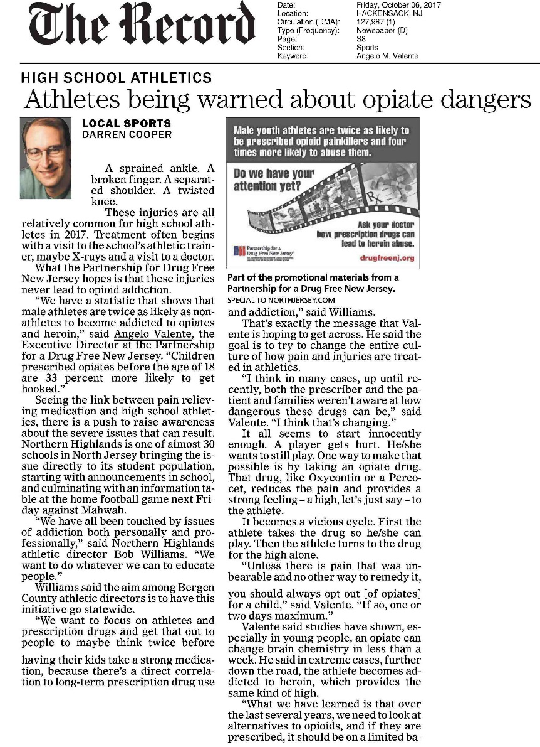
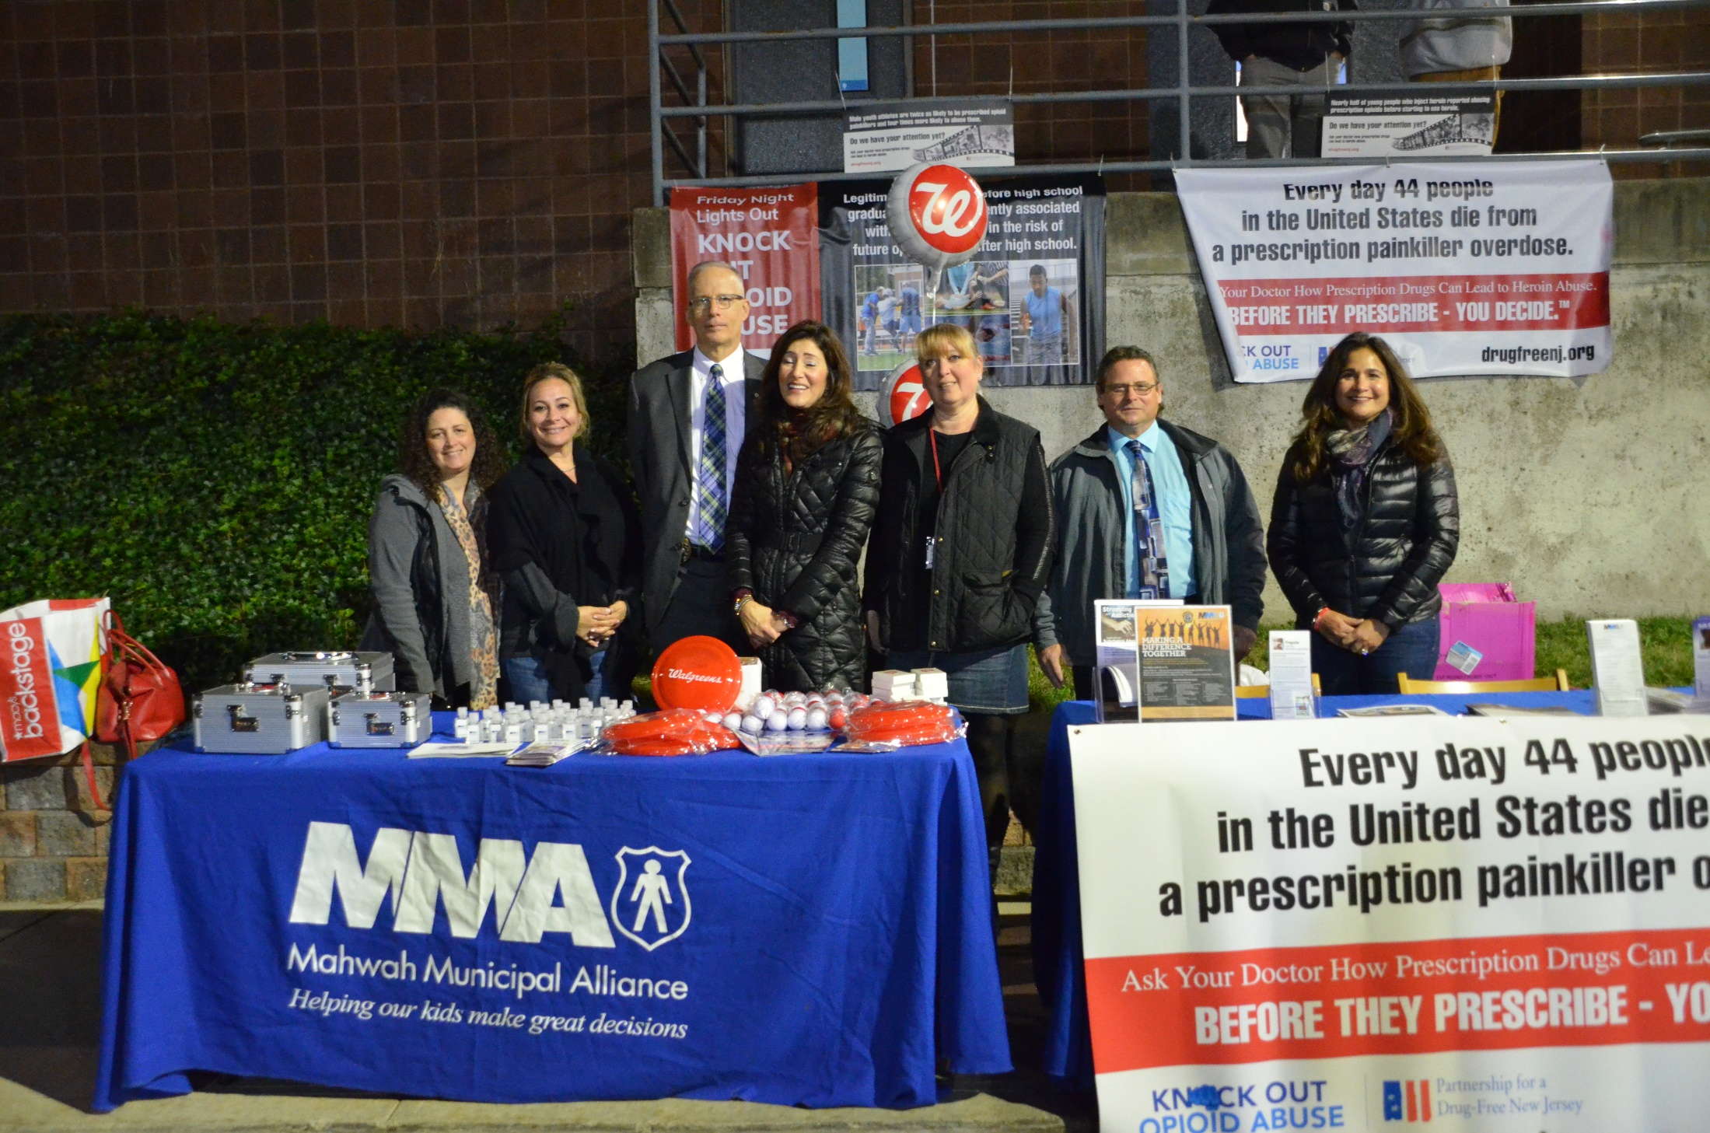
High School Sports

Slide 30
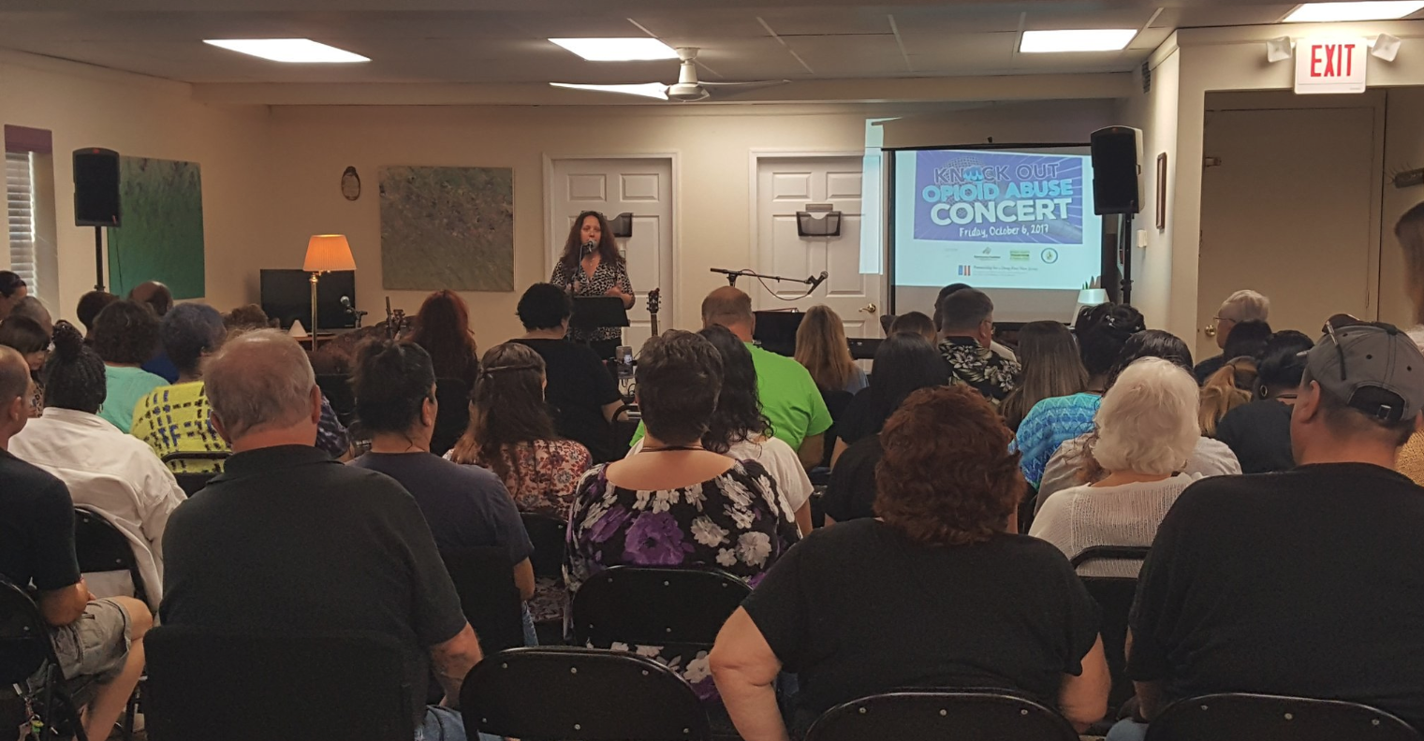

KOOA Songwriters Contest and Concert
Life Center Stage and the Community Coalition for a Safe and Healthy Morris County
Contest winners Anna Toby Rabinowitz and Anna Zibit also won a 2018 NJ Ad Club Jersey Award for their song, “Invisible.”

Slide 31
Media Outreach and Social Media
Media Toolkit:
http://drugfreenj.org/knockoutvolunteers/

Slide 32
Media Outreach and Social Media
Sample advisories/press releases http://drugfreenj.org/knockoutvolunteers/
Social media: Spread the word before/during/after the event
  Tag PartnershipForADrugFreeNewJersey (Facebook); Mention @DrugFreeNJ (Twitter and Instagram)
Questions? media@drugfreenj.org

Slide 33
Questions?

