Slide 1
Knock Out Opioid Abuse Day
October 6, 2018
Notes:
Welcome and housekeeping info from Greg S.

Slide 2
Knock Out Opioid Abuse Day
A project of the Partnership for a Drug-Free New Jersey and The Community Coalition for a Safe and Healthy Morris, in cooperation with the New Jersey Department of Human Services, and Governor’s Council on Alcoholism and Drug Abuse
#KnockOutOpioidAbuse
Notes:
Angelo will provide and overview of the day, introduce the partners on this project and invite each to introduce themselves. Angelo will then discuss the origins of the idea for this project and as Barbara to speak a little bit about the origins of the day. He will then speak about the outreach and commitment of both DHMAS and GCADA in supporting this outreach.

Slide 3
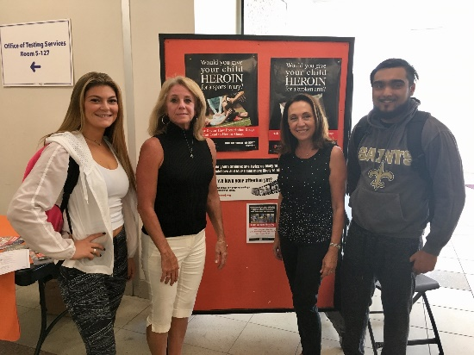
What is it?
October 6, 2018 has been designated Knock Out Opioid Abuse Day in New Jersey.
The statewide single-day initiative will mobilize the prevention and treatment communities, community leaders, and concerned citizens to raise awareness of the potential for dependency on prescribed pain medicine and its link to heroin abuse rates in our state.
The mobilization will have a dual focus: educating physicians and raising awareness among New Jersey citizens and families.
#KnockOutOpioidAbuse
Notes:
Angelo will outline the specifics of the day, and the stats behind getting the information out statewide
According to the CDC, opioid pain relievers that are abused were most often obtained via prescription from physicians. early one in three parents of New Jersey middle school students do not believe there is a link between pain killers prescribed for things like sports injuries and wisdom tooth removal and the rising use of heroin in New Jersey.
The study also found that less than 50 percent of parents feel they are knowledgeable about heroin.

Slide 4
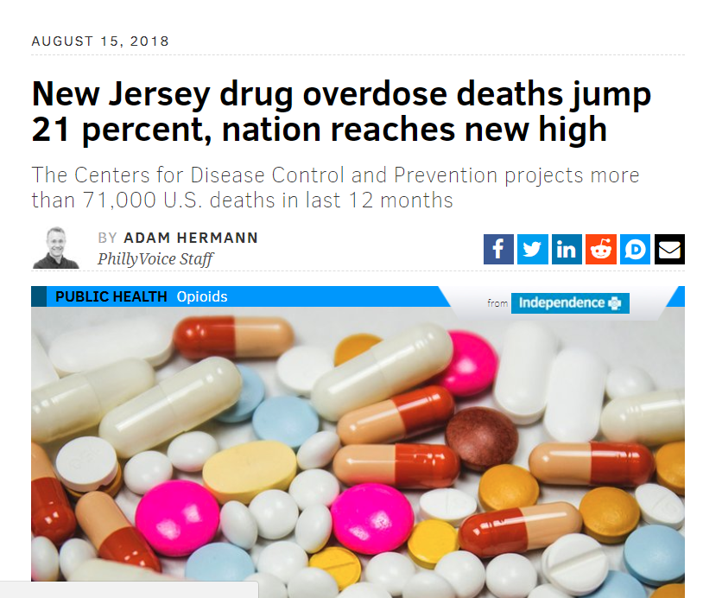
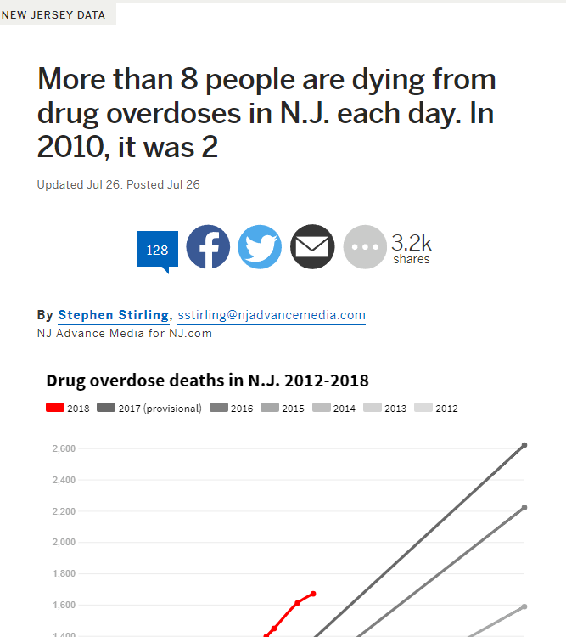
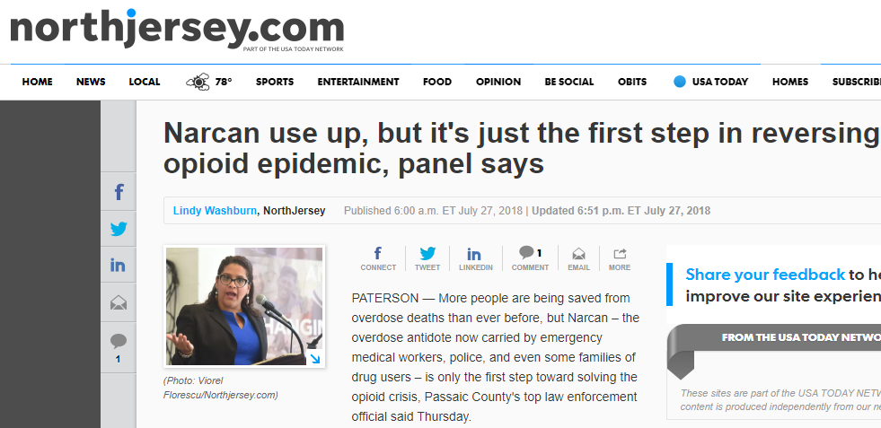
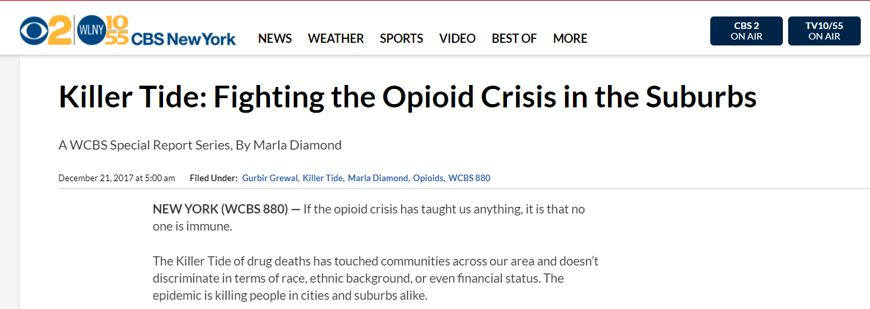
Addressing the Issue
#KnockOutOpioidAbuse

Slide 5
Building on Success..
#KnockOutOpioidAbuse

Slide 6
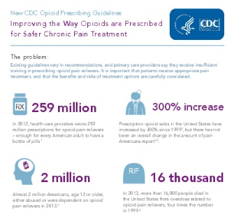
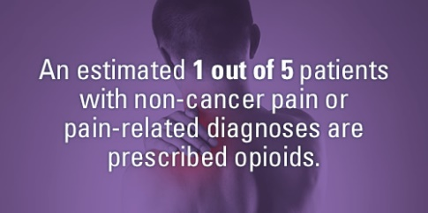

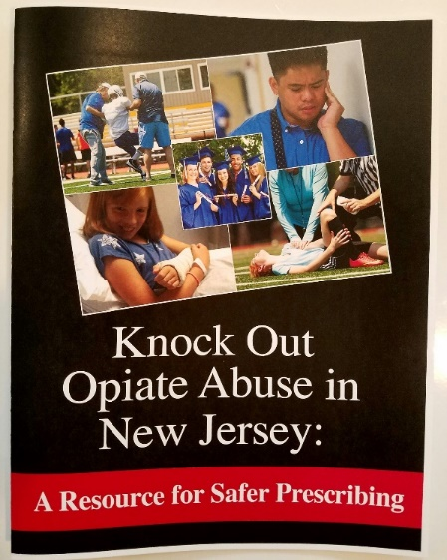
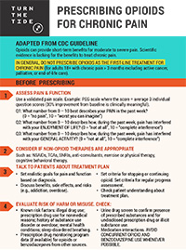

Outreach to Prescribers and Families
Building on Success...
Resource Guides
Turn The Tide Pocket Cards
#KnockOutOpioidAbuse

Slide 7
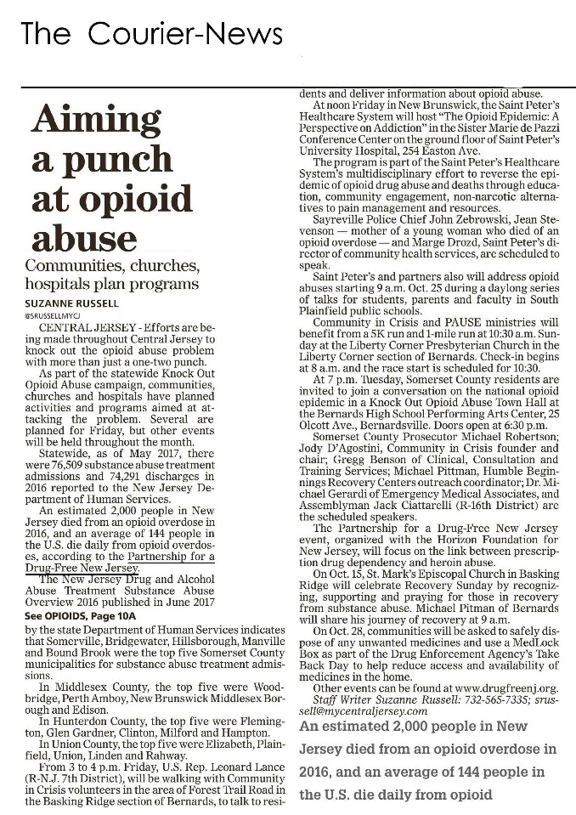
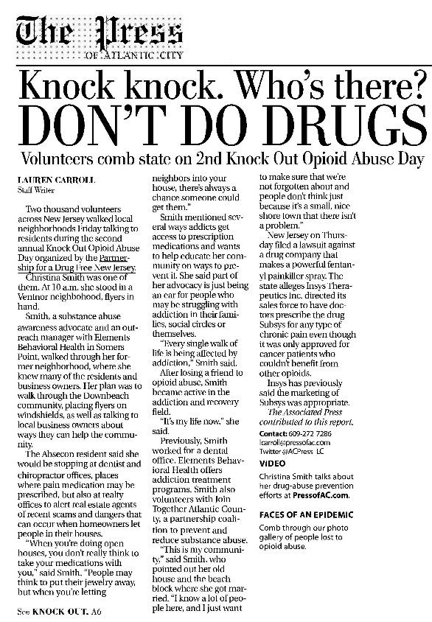
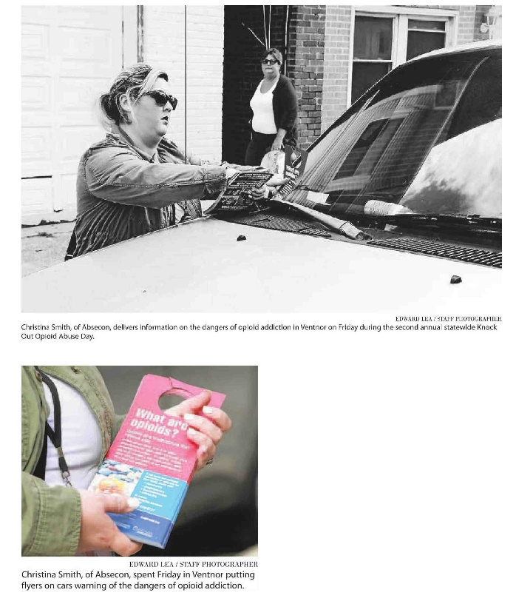
More than 10,000 Volunteers Across NJ
Building on Success...
#KnockOutOpioidAbuse

Slide 8
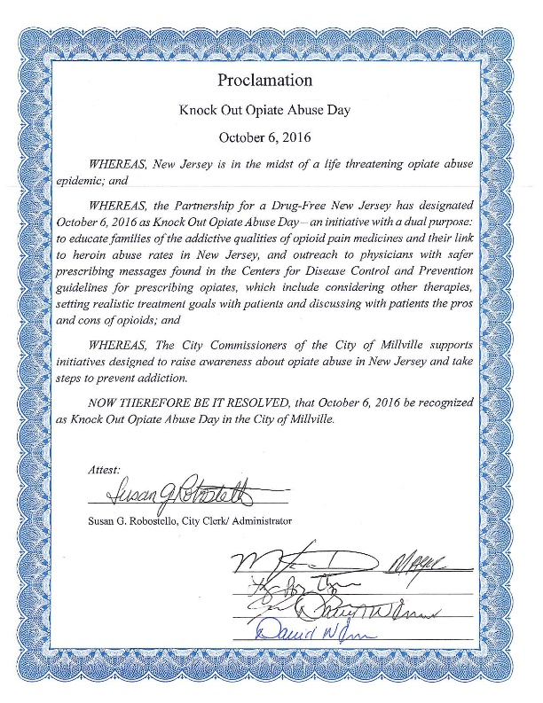
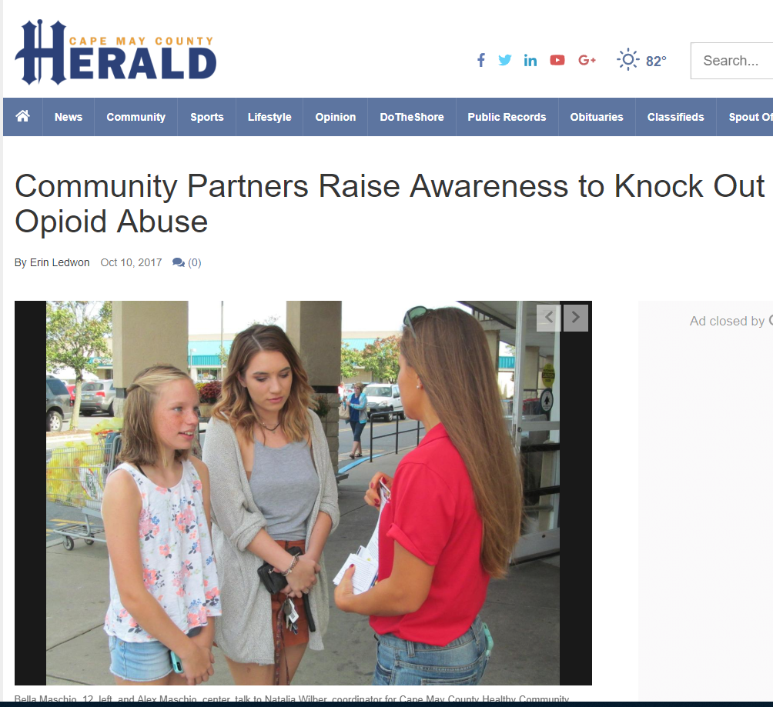
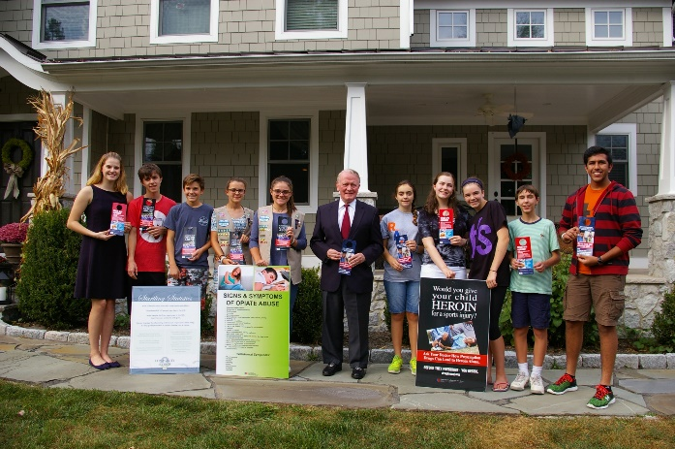
Building on Success...
Senate designation of Annual Knock Out Opioid Abuse Day on October 6thn
#KnockOutOpioidAbuse

Slide 9
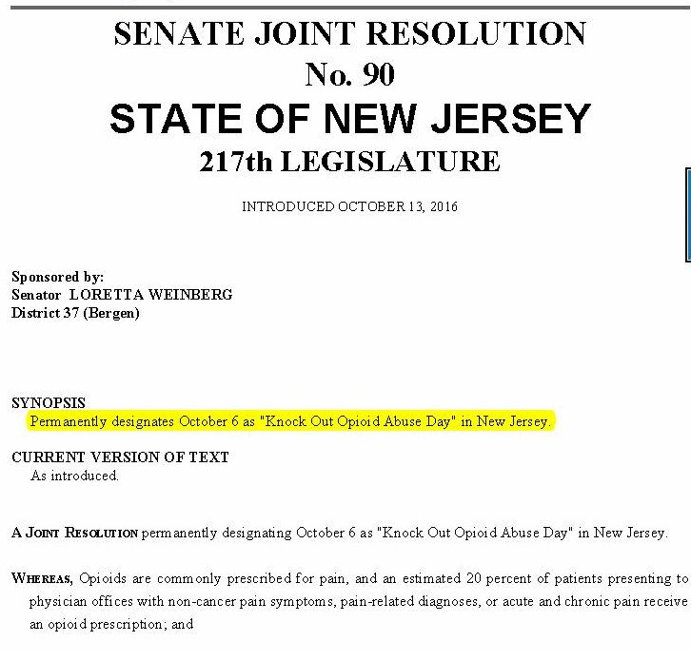
Building on Success...
#KnockOutOpioidAbuse

Slide 10

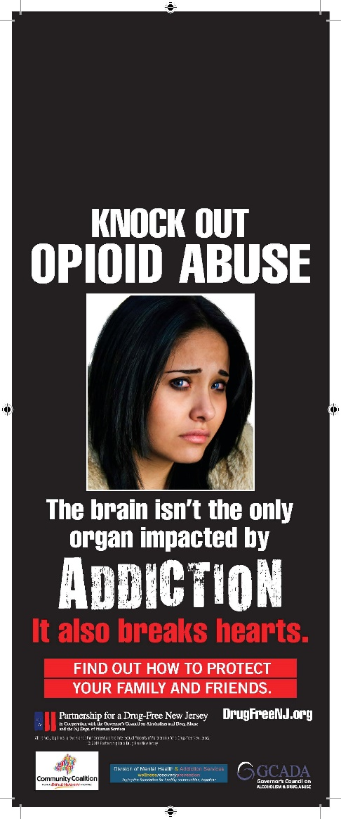
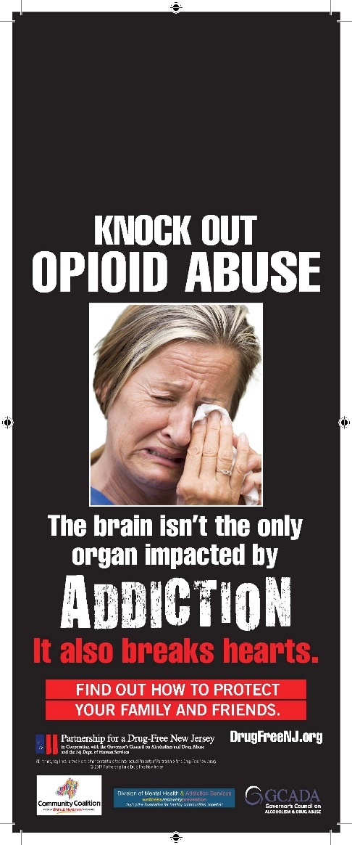
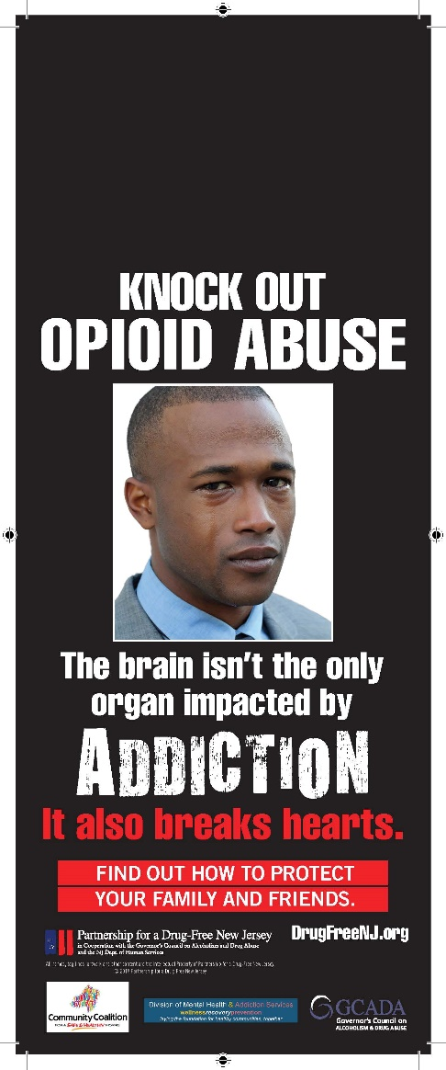
2018
New Door Hangers
#KnockOutOpioidAbuse

Slide 11




2018
New Door Hangers
#KnockOutOpioidAbuse

Slide 12
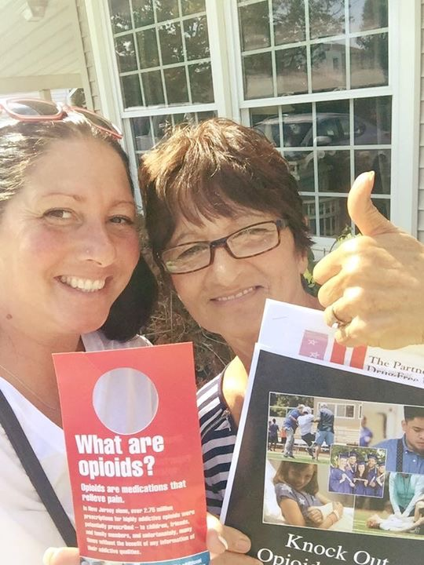

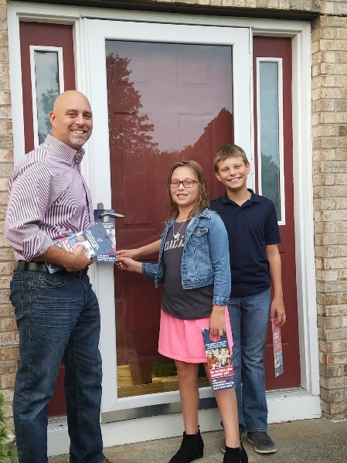
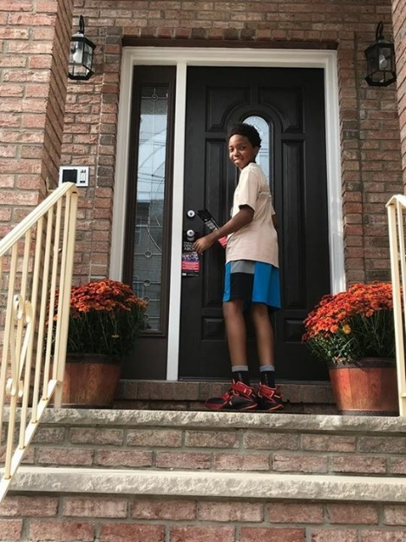
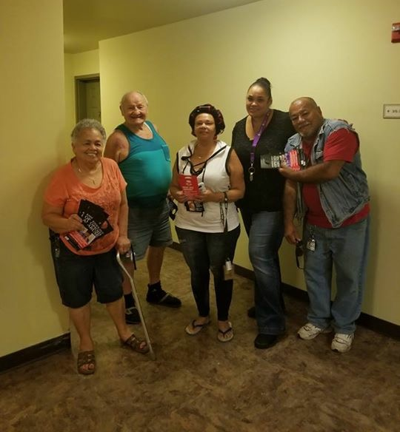
Outreach to Residents and Families
#KnockOutOpioidAbuse
Notes:
Angelo will describe the outreach to families, noting that at the trainings to be held in September, each volunteer coordinator will be provided with door knockers for each of the volunteers in an area to use in their neighborhood/community. Outreach to homes/families can occur any time appropriate for the community on October 6, 2017.
Postcards will be an additional resource for neighborhoods with solicitation/no-knock laws.

Slide 13

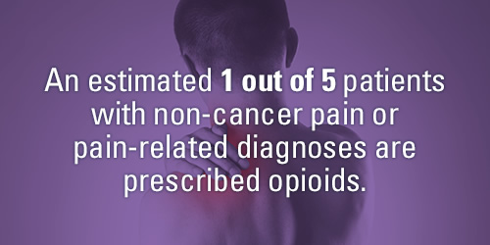
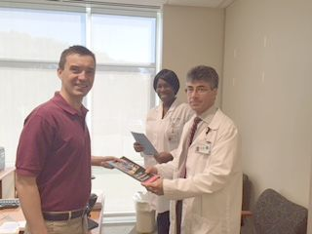
Outreach to Prescribers:
Physicians/Dentists
#KnockOutOpioidAbuse
Notes:
Angelo will discuss the outreach to physicians. Noting that each county leader will receive a list of prescribers – physicians and dentists. Outreach will take place from 10 am to 12 pm and from 2 pm to 4 pm. Volunteers will be provided with a resource guide to leave each prescriber they visit which will include the CDC guidelines, information about sigma reduction, and a sign to display in their location.

Slide 14
#KnockOutOpioidAbuse

Slide 15

Additional Resources..
#KnockOutOpioidAbuse

Slide 16
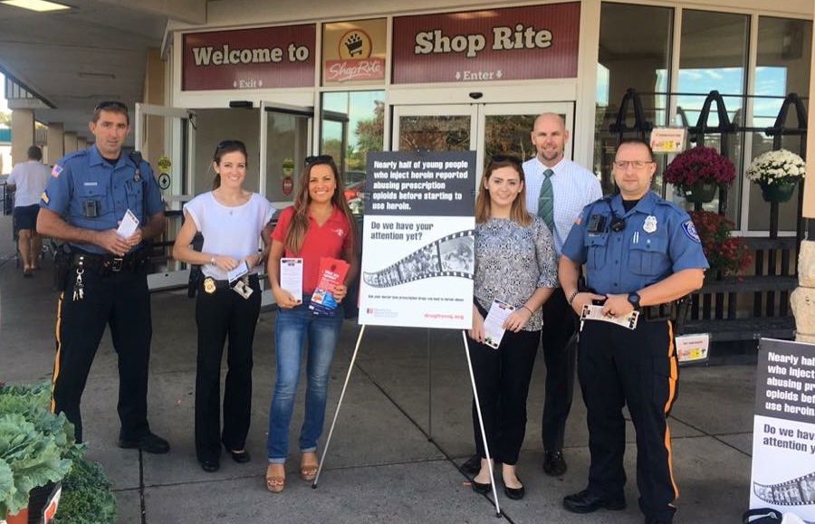
Coordination:
County Teams
Outreach: Media and Prescriber List
#KnockOutOpioidAbuse
Notes:
Anyone interested in being a team leader in their County should follow the instructions they will receive in the post Webinar email.
PDFNJ will coordinate the outreach on the day of the event to the media and will provide the prescriber list to each team leader
Trainings outlining these details will be open to all volunteers on August 15th and 30th from 7 pm to 9 pm. They will include an overview of the epidemic and outreach initiative, and material distribution.
Barbara will discuss the Focus on celebrity door knockers which will generate interest and publicity. Information on how to suggest a local celebrity will be included in the post webinar email.

Slide 17
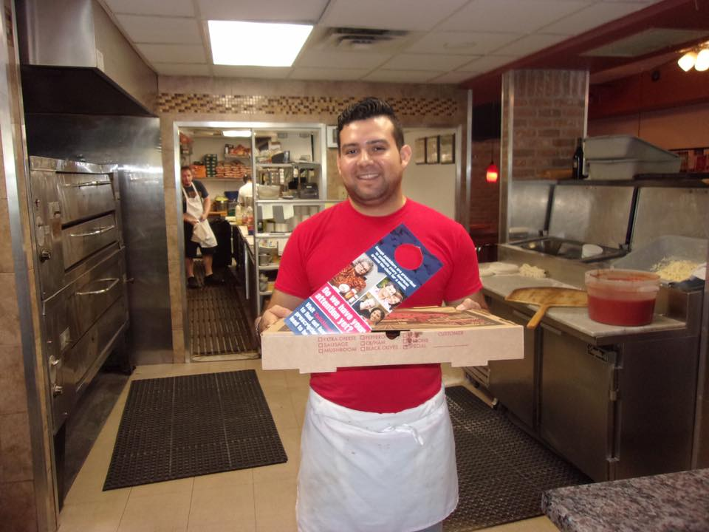
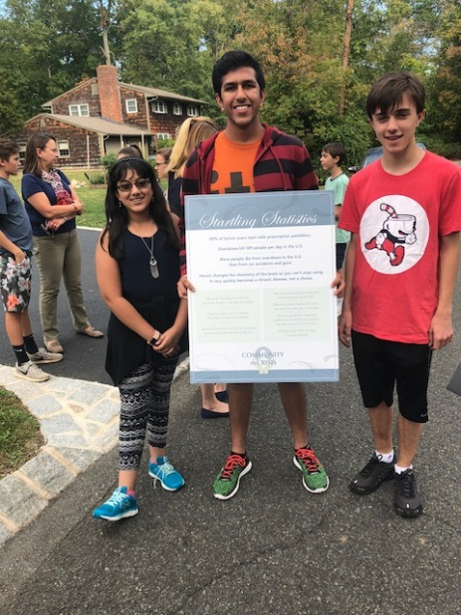
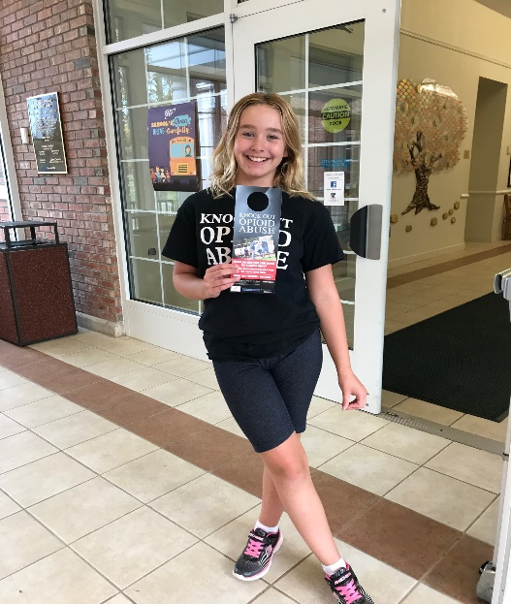
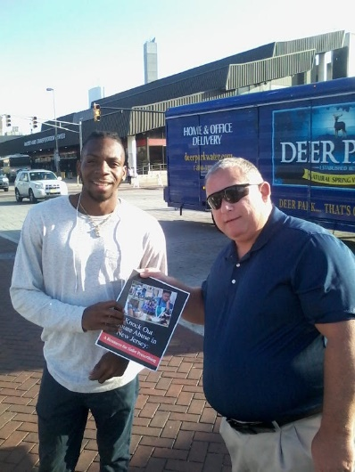
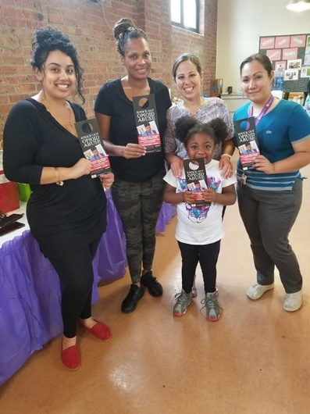
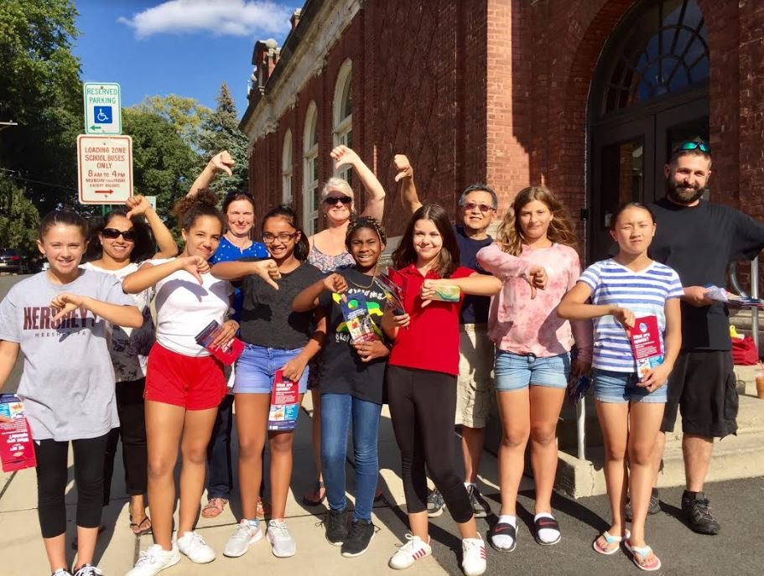
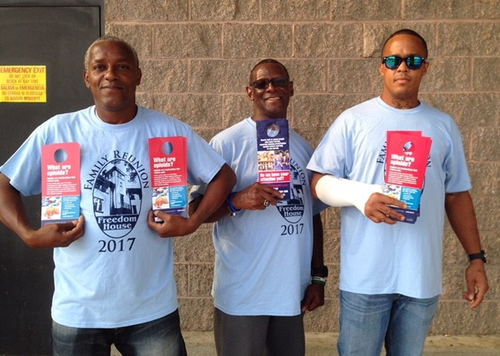
Our 2017 Supporters
#KnockOutOpioidAbuse

Slide 18
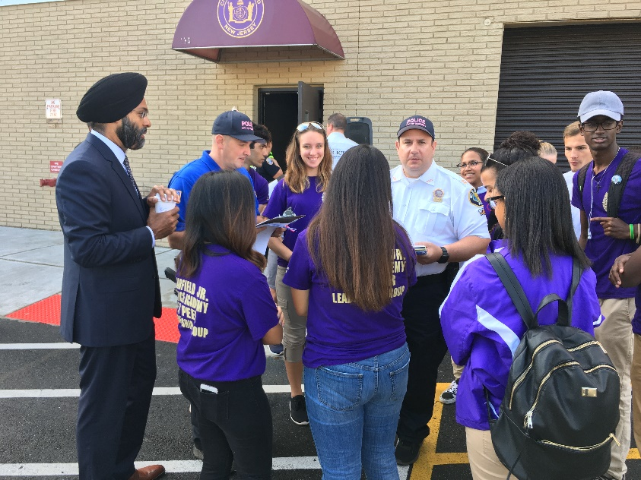
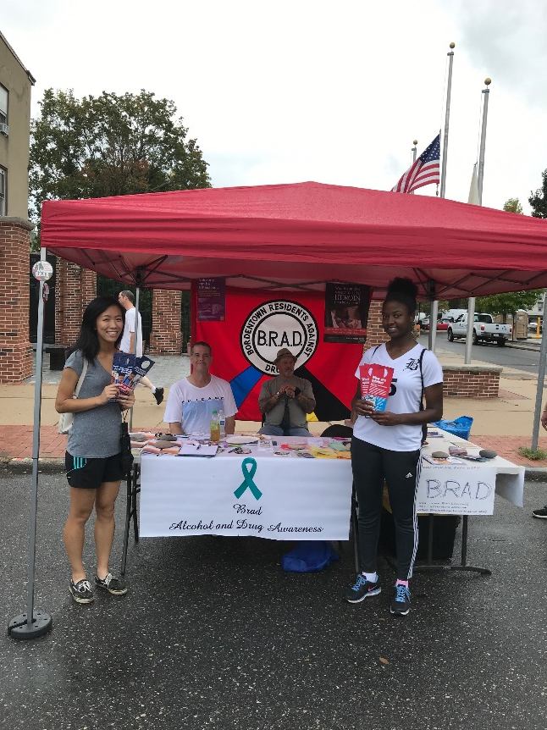
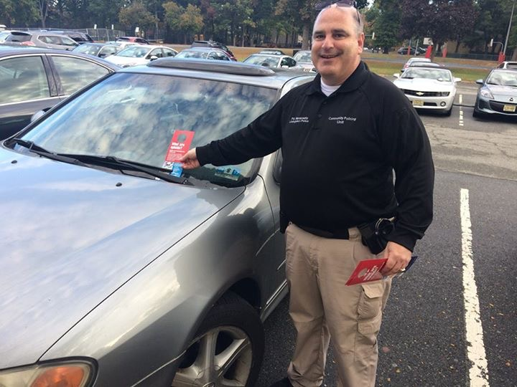
Success Strategies
#KnockOutOpioidAbuse

Slide 19
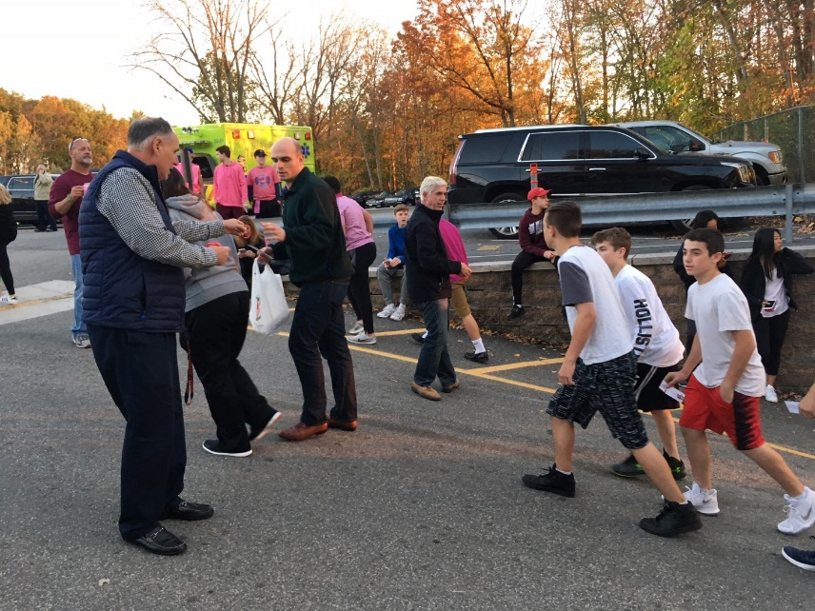
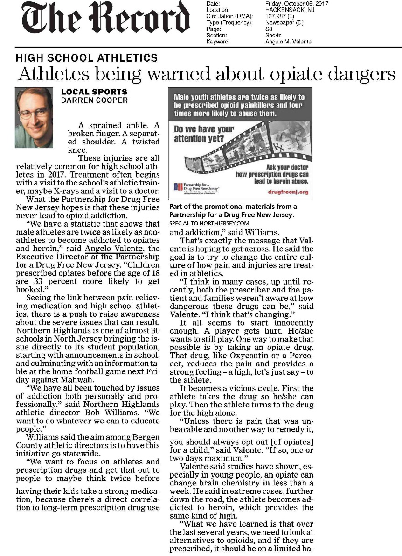
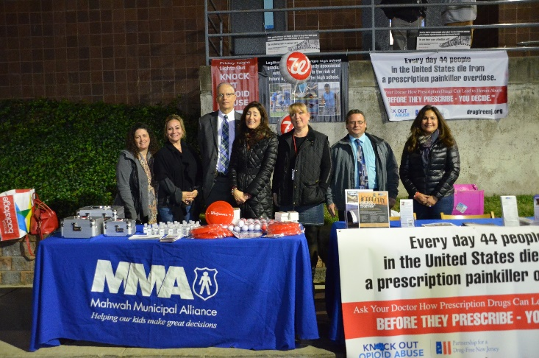
High School Sports

Slide 20
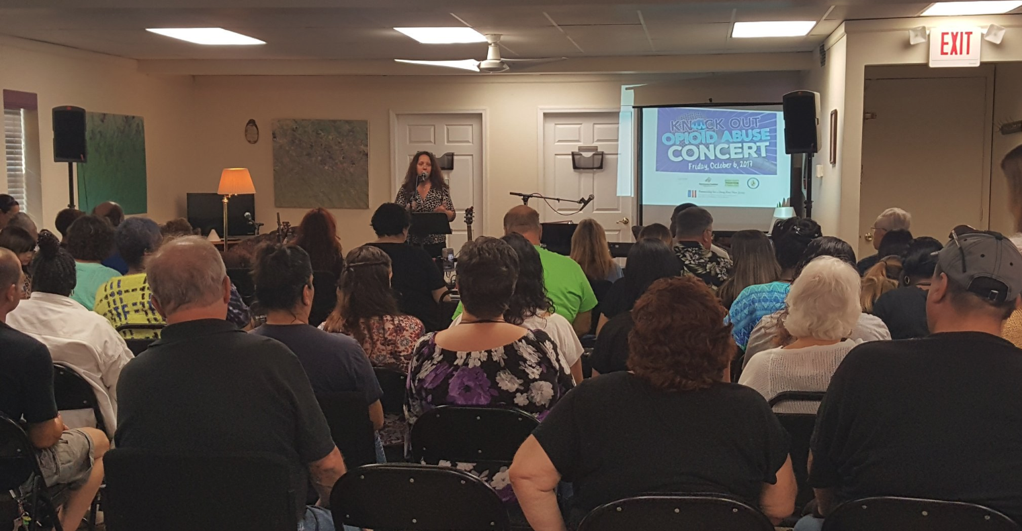

KOOA Songwriters Contest and Concert
Life Center Stage and the Community Coalition for a Safe and Healthy Morris County
Contest winners Anna Toby Rabinowitz and Anna Zibit also won a 2018 NJ Ad Club Jersey Award for their song, “Invisible.”
#KnockOutOpioidAbuse

Slide 21
Media Outreach and Social Media
Media Toolkit:
http://drugfreenj.org/knockoutvolunteers/
#KnockOutOpioidAbuse

Slide 22
Media Outreach and Social Media
Sample advisories/press releases/letters http://drugfreenj.org/knockoutvolunteers/
Social media: Spread the word before/during/after the event
  Tag PartnershipForADrugFreeNewJersey (Facebook); Mention @DrugFreeNJ (Twitter and Instagram)
  Use the hashtag #KnockOutOpioidAbuse
#KnockOutOpioidAbuse

Slide 23
Media Outreach and Social Media
Questions about media outreach? Email Matt Birchenough at media@drugfreenj.org.
Questions about materials? Email David Philemon at marketing@drugfreenj.org.
#KnockOutOpioidAbuse

Slide 24
Questions?
#KnockOutOpioidAbuse

