Slide 1
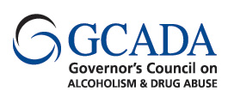
Overview of Substance Abuse Prevention
Rebecca Alfaro
Deputy Executive Director
New Jersey Governor’s Council on Alcoholism and Drug Abuse

Slide 2
What is Prevention?
According to the Substance Abuse and Mental Health Services Administration:
Preventing mental and/or substance use disorders and related problems in children, adolescents, and young adults is critical to Americans’ behavioral and physical health. Behaviors and symptoms that signal the development of a behavioral disorder often manifest two to four years before a disorder is present. In addition, people with a mental health issue are more likely to use alcohol or drugs than those not affected by a mental illness. If communities and families can intervene early, behavioral health disorders might be prevented, or symptoms can be mitigated.
Substance Abuse and Mental Health Services Administration. 2014. Retrieved from http://www.samhsa.gov/prevention

Slide 3
Prevention is Cost Saving
In addition, the Institute of Medicine and National Research Council’s Preventing Mental, Emotional, and Behavioral Disorders Among Young People report (2009) notes that cost-benefit ratios for early treatment and prevention programs for addictions and mental illness programs range from 1:2 to 1:10. This means a $1 investment yields $2 to $10 savings in health costs, criminal and juvenile justice costs, educational costs, and lost productivity.
Substance Abuse and Mental Health Services Administration. 2014. Retrieved from http://www.samhsa.gov/prevention

Slide 4
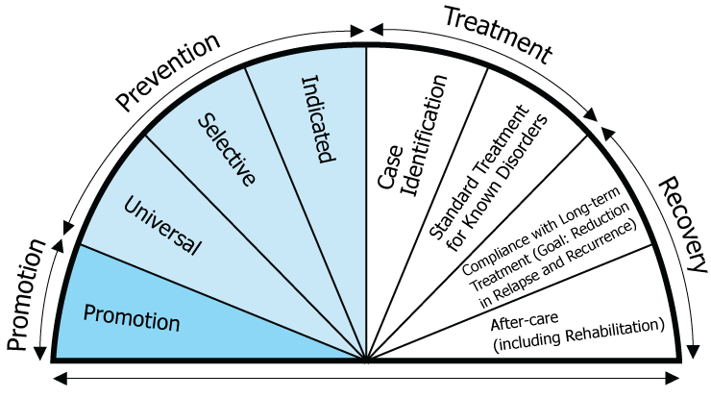
Continuum of Care
Substance Abuse and Mental Health Services Administration. 2014. Retrieved from http://www.samhsa.gov/prevention

Slide 5
New Jersey’s Plan for Change
Strategic Prevention Framework
Public Health Approach to Prevention
Community-Level Change Strategies
Comprehensive Programs
Support Coalition-Based Prevention Efforts
Notes:
What does this look like in action? How is this operationalized?

Slide 6
Prevention Science
Strategic Prevention Framework
Notes:
In the last 20 years, prevention research has reached a level of credibility never seen before.
Research based in outcome studies, cost saving analysis and overall efficacy in changing population norms.
The SPF is a research-based data-driven community problem solving process.

Slide 7
New Jersey Substance Abuse Prevention Strategic Plan
Problem Drinking
Underage Drinking
Binge Drinking
Adult Problem Drinking
Medication Misuse
Prescription Drug Abuse
Illegal Drug Use
Heroin
Marijuana
New and Emerging Drugs
Bath salts, K2, spice, Smiles, Molly

Slide 8
New Jersey and You: Working Together
Multi-Faceted Prevention Planning
Regional Coalition Needs Assessment
Municipal Alliance Needs Assessment
County Needs Assessment
Reviews Regional NA & Alliance NA & Other County Data
Focused on State Priorities
Reviews Regional Coalition Results and other local data
State Prevention Planning
Determined Four State Priorities

Slide 9
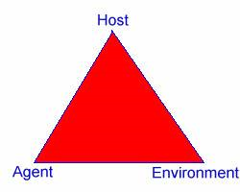
Community Level Change
Prevention efforts, utilizing the public health approach, are aimed at changing or influencing community conditions rather then individuals or groups of individuals

Slide 10
CADCA’s Seven Strategies to Effect Community-Level Change
CADCA: Community Anti-Drug Coalitions of America
Provide Information
Build Skills
Provide Support
Reduce Barriers and Enhance Access
Change Consequences
Change Physical Design
Modify Policy
Notes:
Criteria for selecting interventions:
Fit with the local diagnosis (local condition)
Must address the condition and be supported by the data
Capacity to implement
What can the community actually accomplish?
Can the interventions be sustained?
Evidence of effectiveness
Prevention science, community experience, and relevant evidence collected outside the field of ATOD (youth services, public health, etc)
Must be part of a comprehensive plan
Takes a comprehensive response to make change
The more strategies used, the greater the likelihood for change

Slide 11
Strategies for Change
Provide Information:
Church bulletin
Town hall meetings
Build Skills
Curriculum program- Strengthening Families, Life Skills Training
Trainings for sectors within the community- religious leaders, pediatricians, real estate agents, etc
Provide Support
Mentoring program, supportive programs
Alternative activities

Slide 12
Strategies for Change
Reduce Barriers and Increase Access
Offer materials in other languages
Offer trainings on-site
Change Consequences
Recognition events and public awareness
Use opportunities to deter negative activity
Change the Physical Design
Signage in the place of worship
Bushes and landscaping, if blocking visibility in a place of access
Modify Policy
Changing community systems or practices
Encourage use of the medication drop box locations

Slide 13
Comprehensive Programming
Comprehensive direct service programs will:
Meet the needs of the community
May be evidence-based from the National Registry of Evidence Based Programs and Practices
May collect empirical data to support outcomes
Account for community readiness
Reduce barriers and create opportunities for high-risk youth and families
Complement the cultural composition of the community

Slide 14
Prevention Unification
What Can I Do
What Can You Do
What Can We Do

Slide 15
Making a Difference
Encourage Use of Drop Boxes | Forming Partnerships with Community Prevention Entities | Promoting Provider Awareness, such as Prevention Works
Taking Part in the Awareness Campaign: Addiction Does Not Discriminate | Engage in Town Hall Meetings | Providing training for stakeholders, such as Mental Health First Aid

Slide 16
Thank you!
Governor’s Council on Alcoholism and Drug Abuse: www.gcada.nj.gov
Addiction Does Not Discriminate Campaign: www.Knowaddiction.nj.gov

